Slide 1
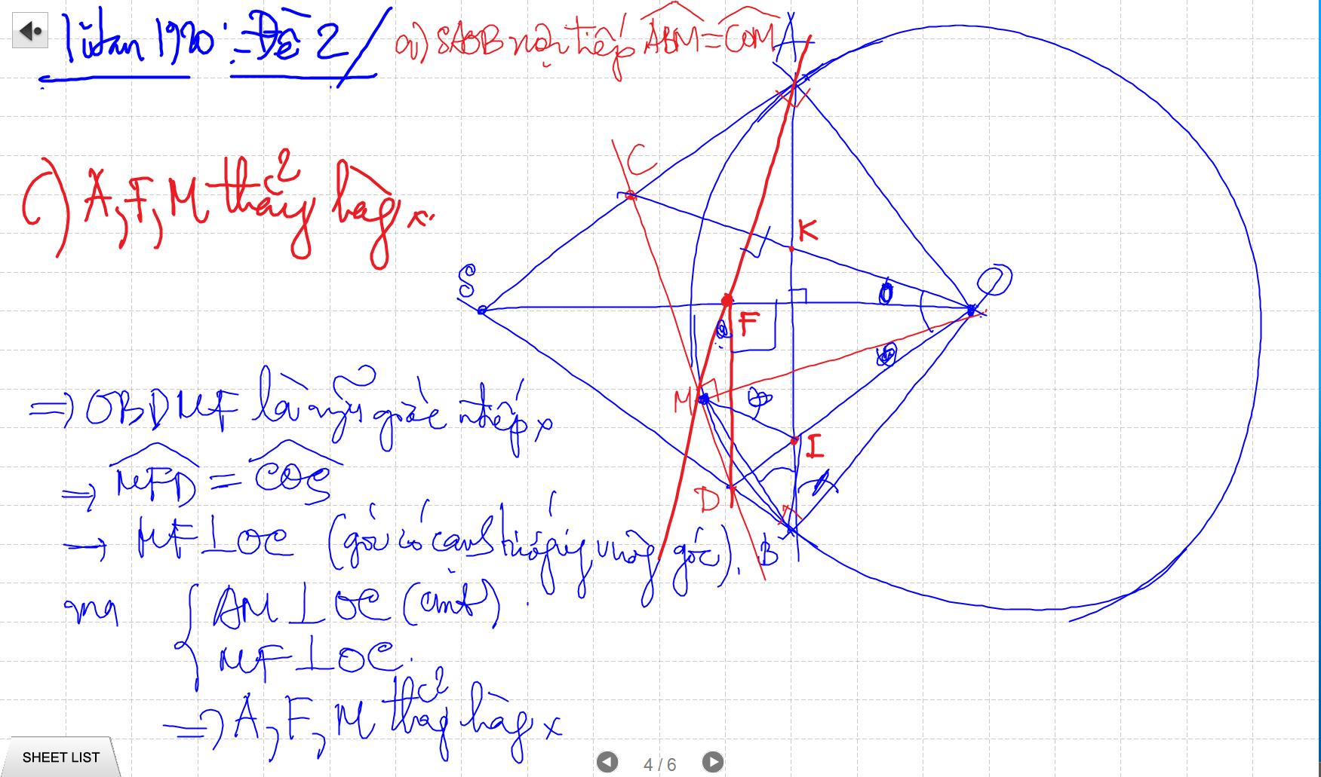

Slide 2
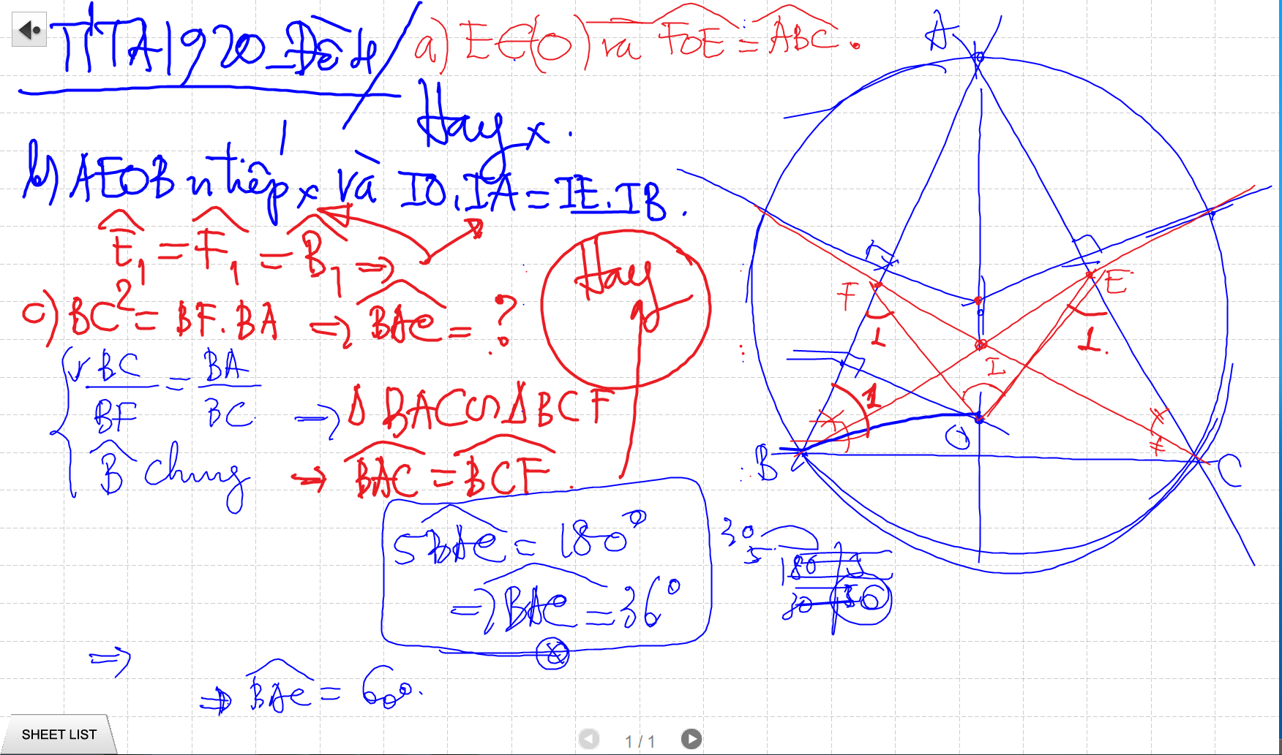

Slide 3
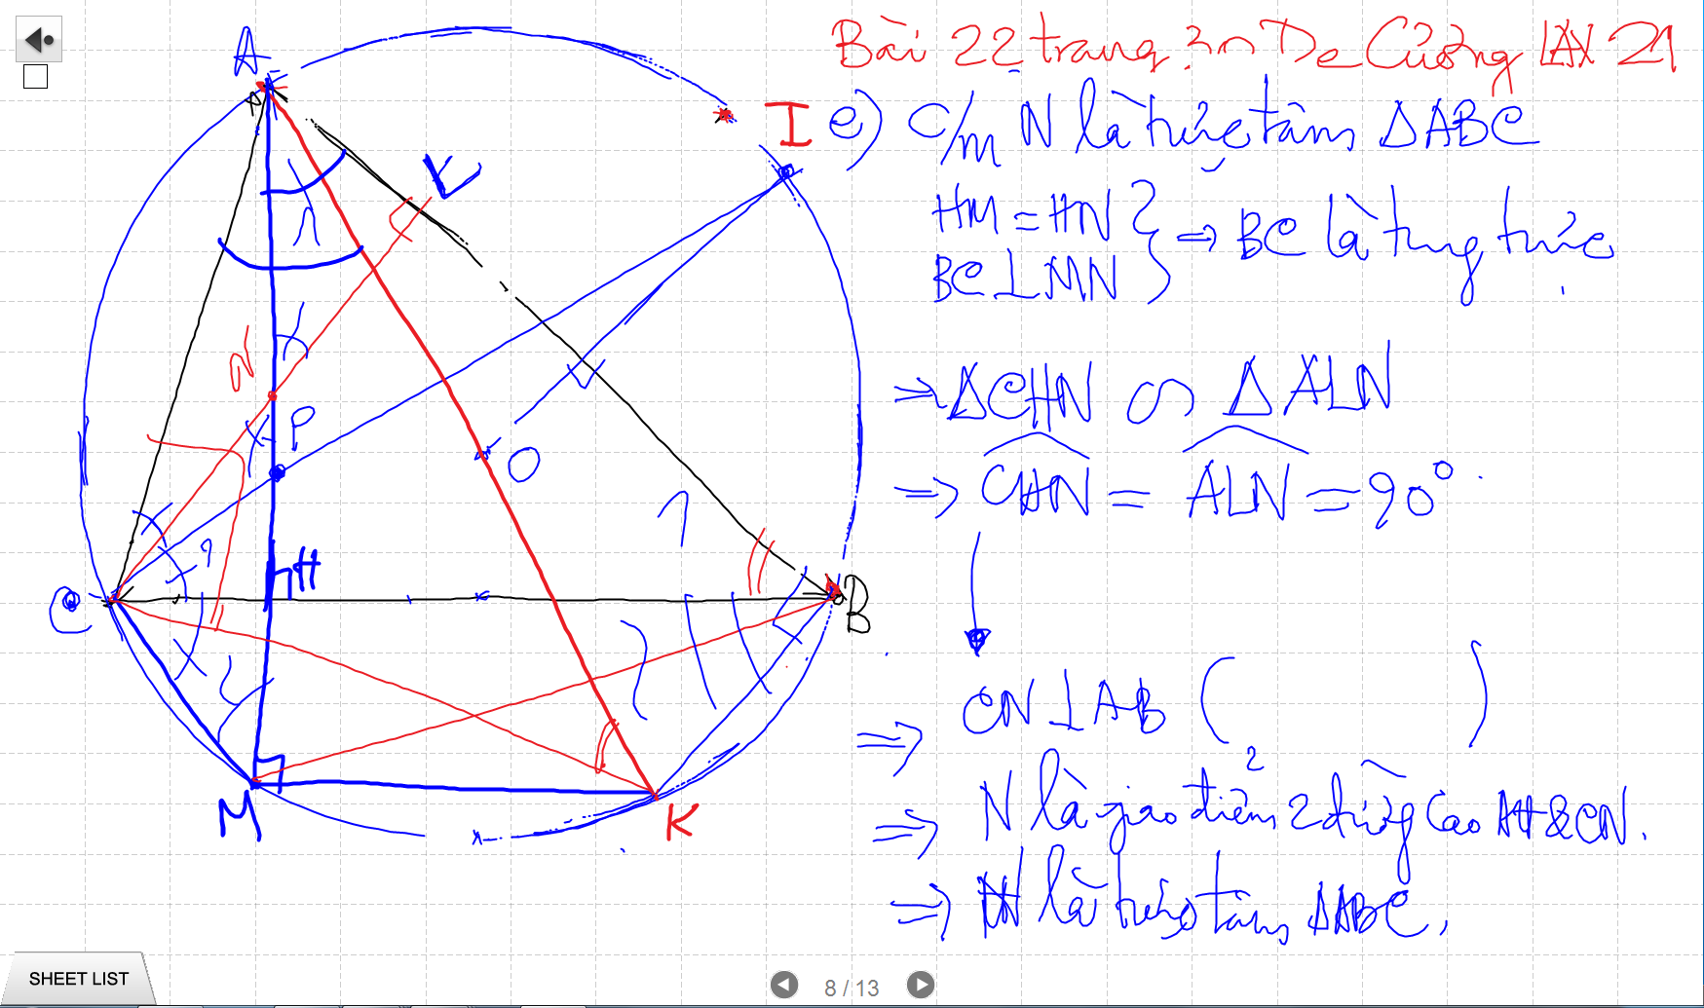

Slide 4
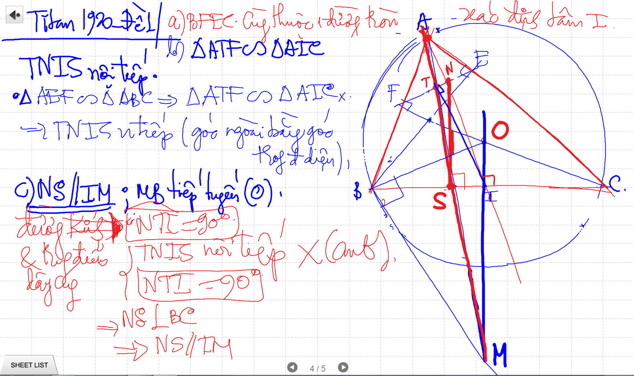

Slide 5
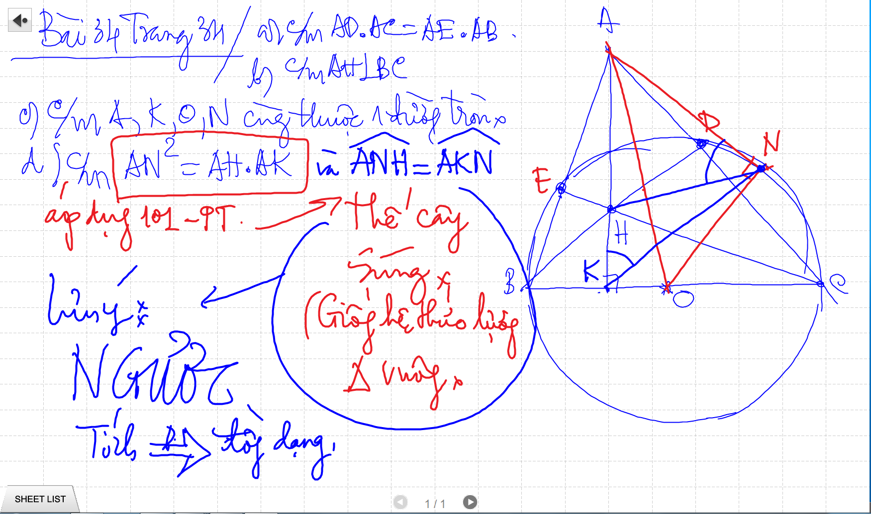

Slide 6
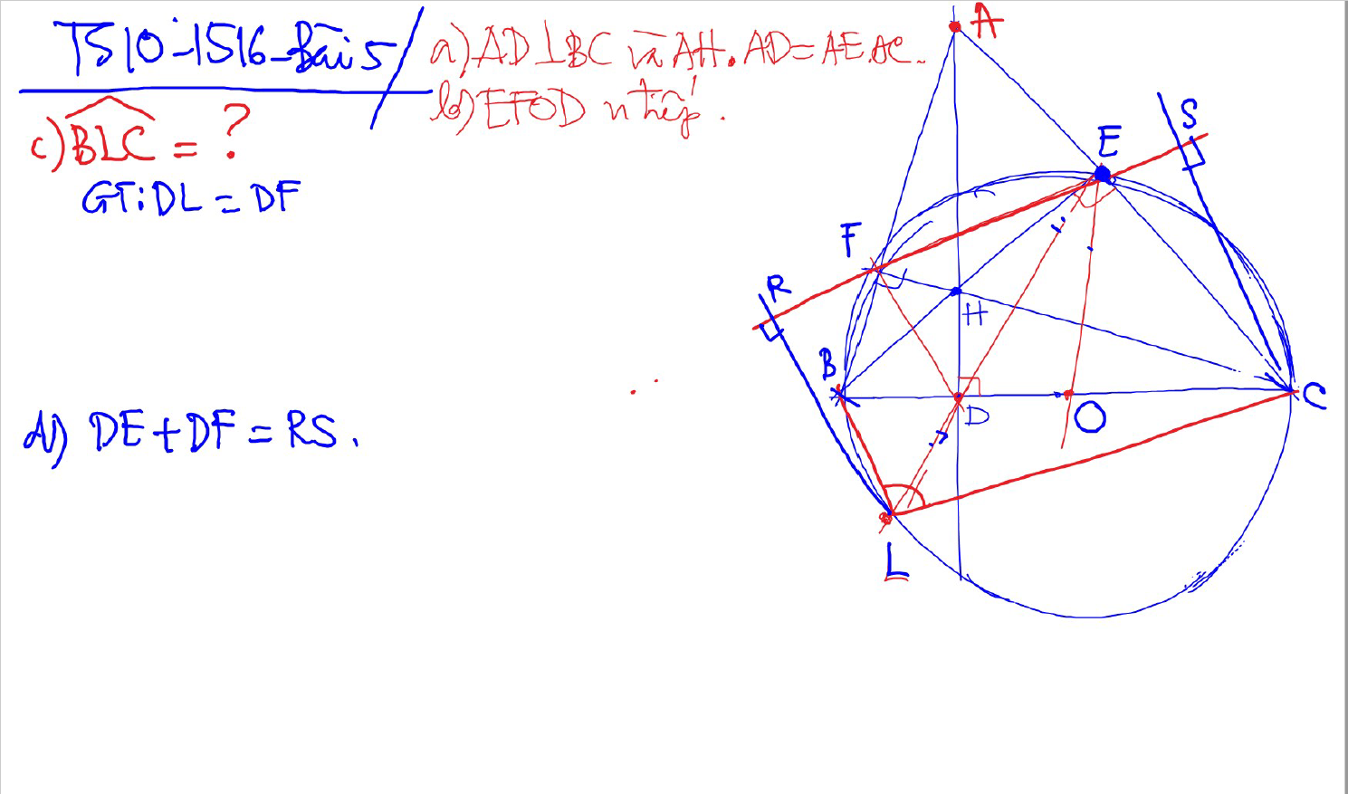
C/m tam giac dong dang truong hop 2

Slide 7
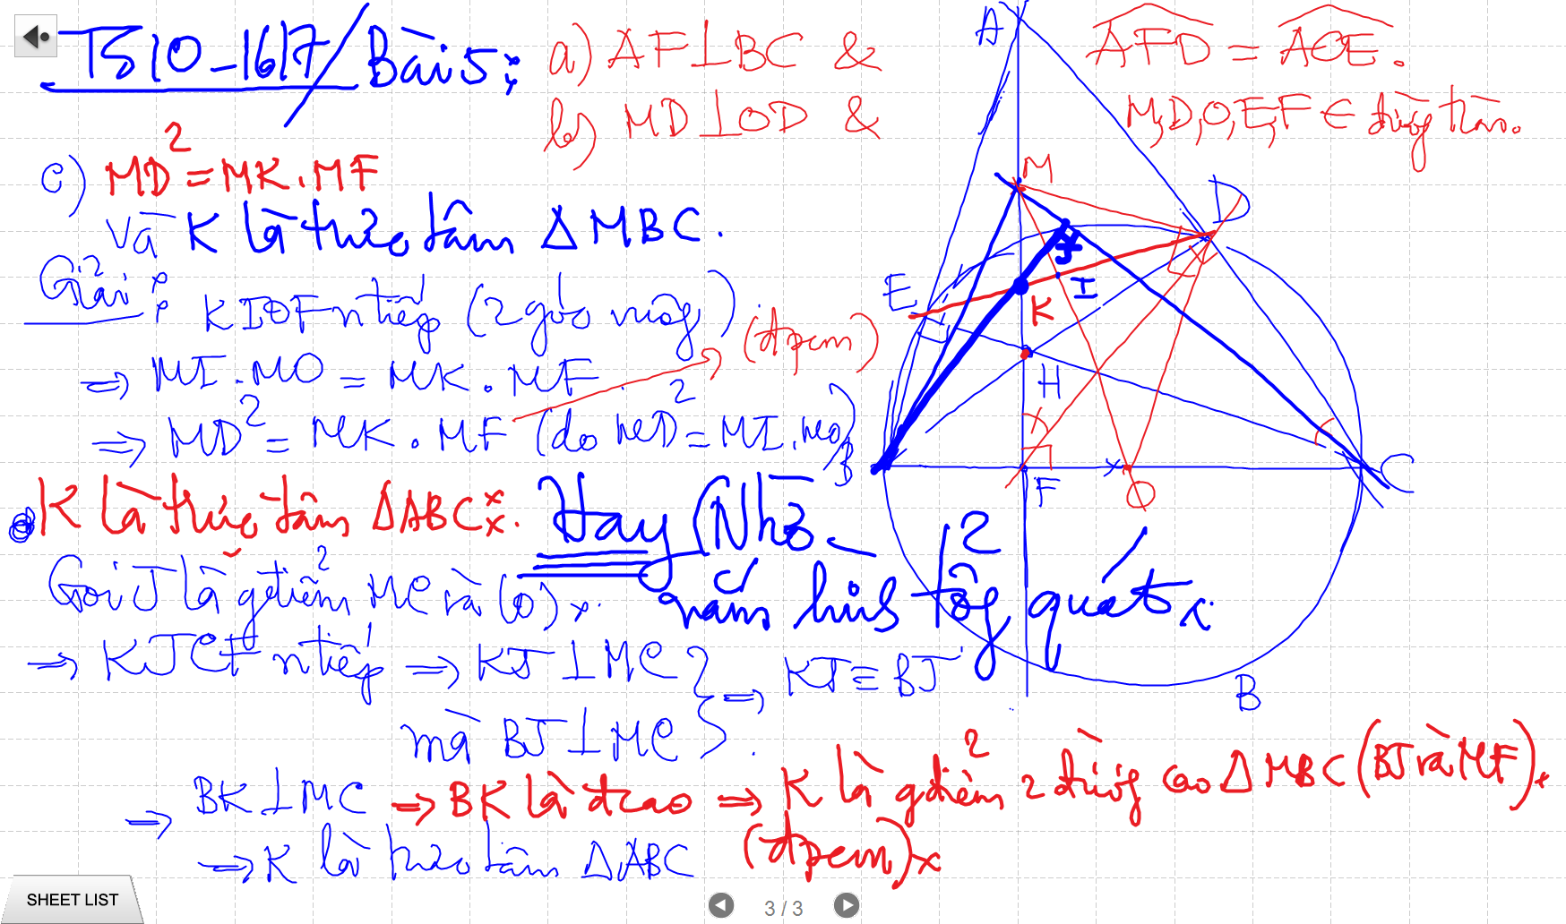
C/m tam giac dong dang truong hop 2

Slide 8
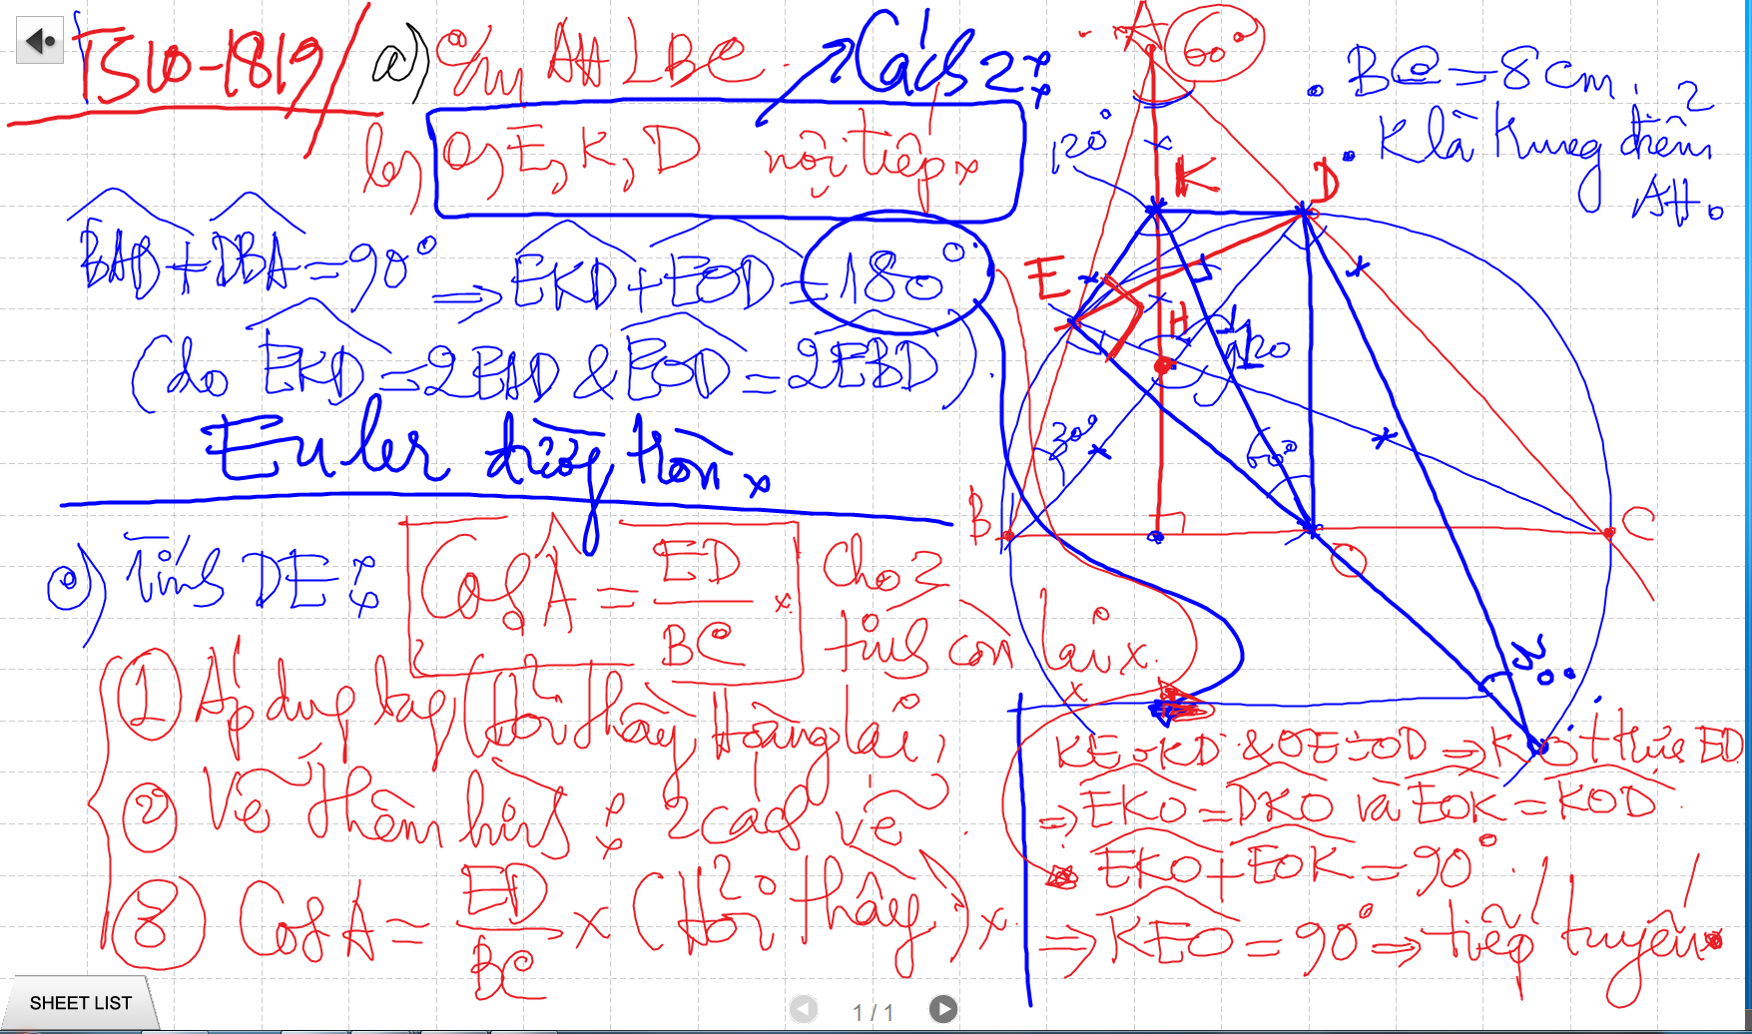
Bai 53 De Cuong – Euler

Slide 9
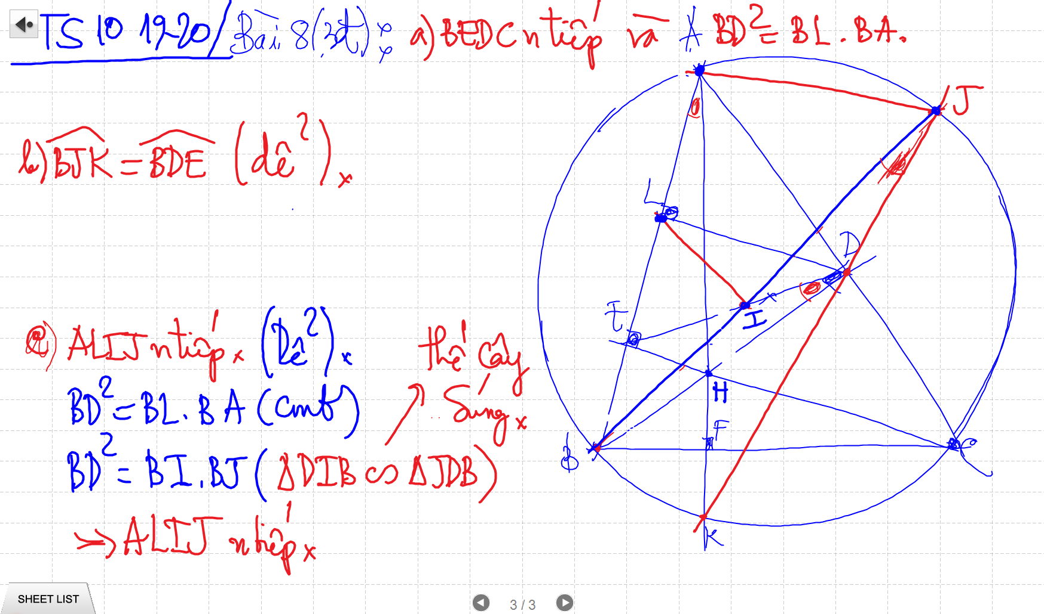
Bai 53 De Cuong – Euler

Slide 10
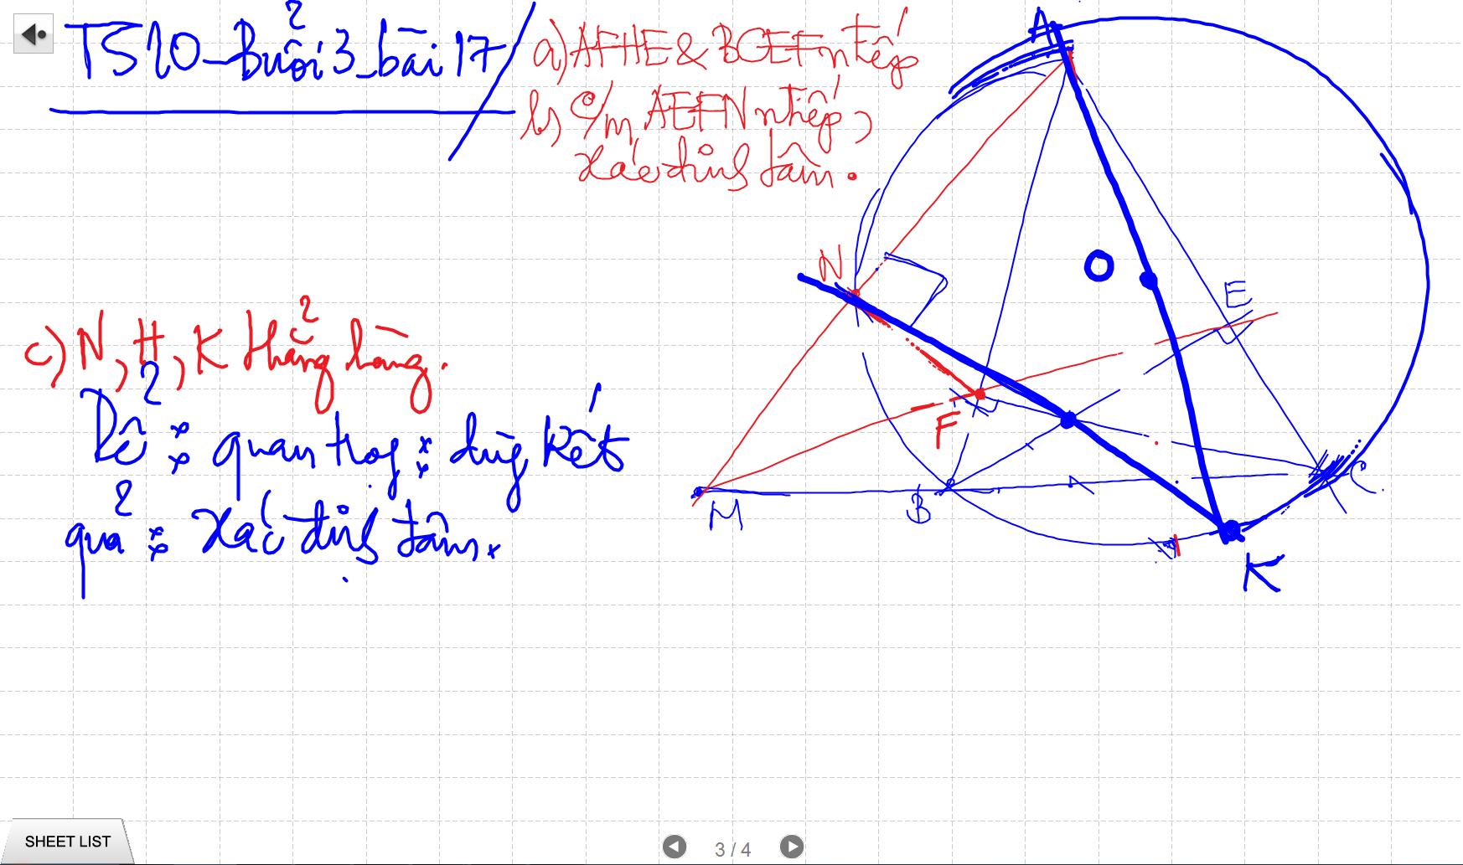
C/m tam giac dong dang truong hop 2

Slide 11
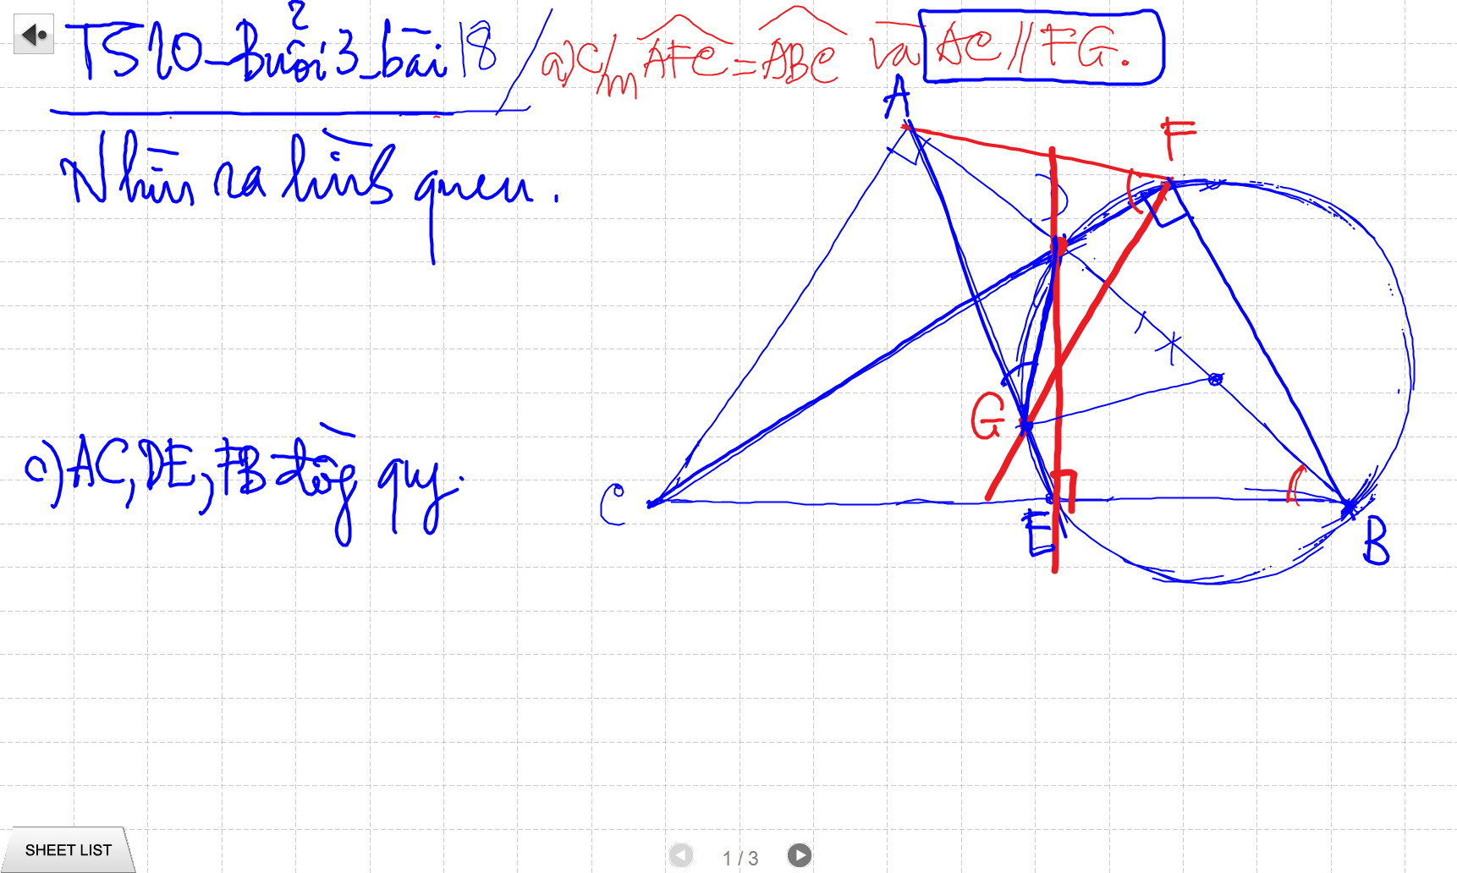
C/m tam giac dong dang truong hop 2

Slide 12
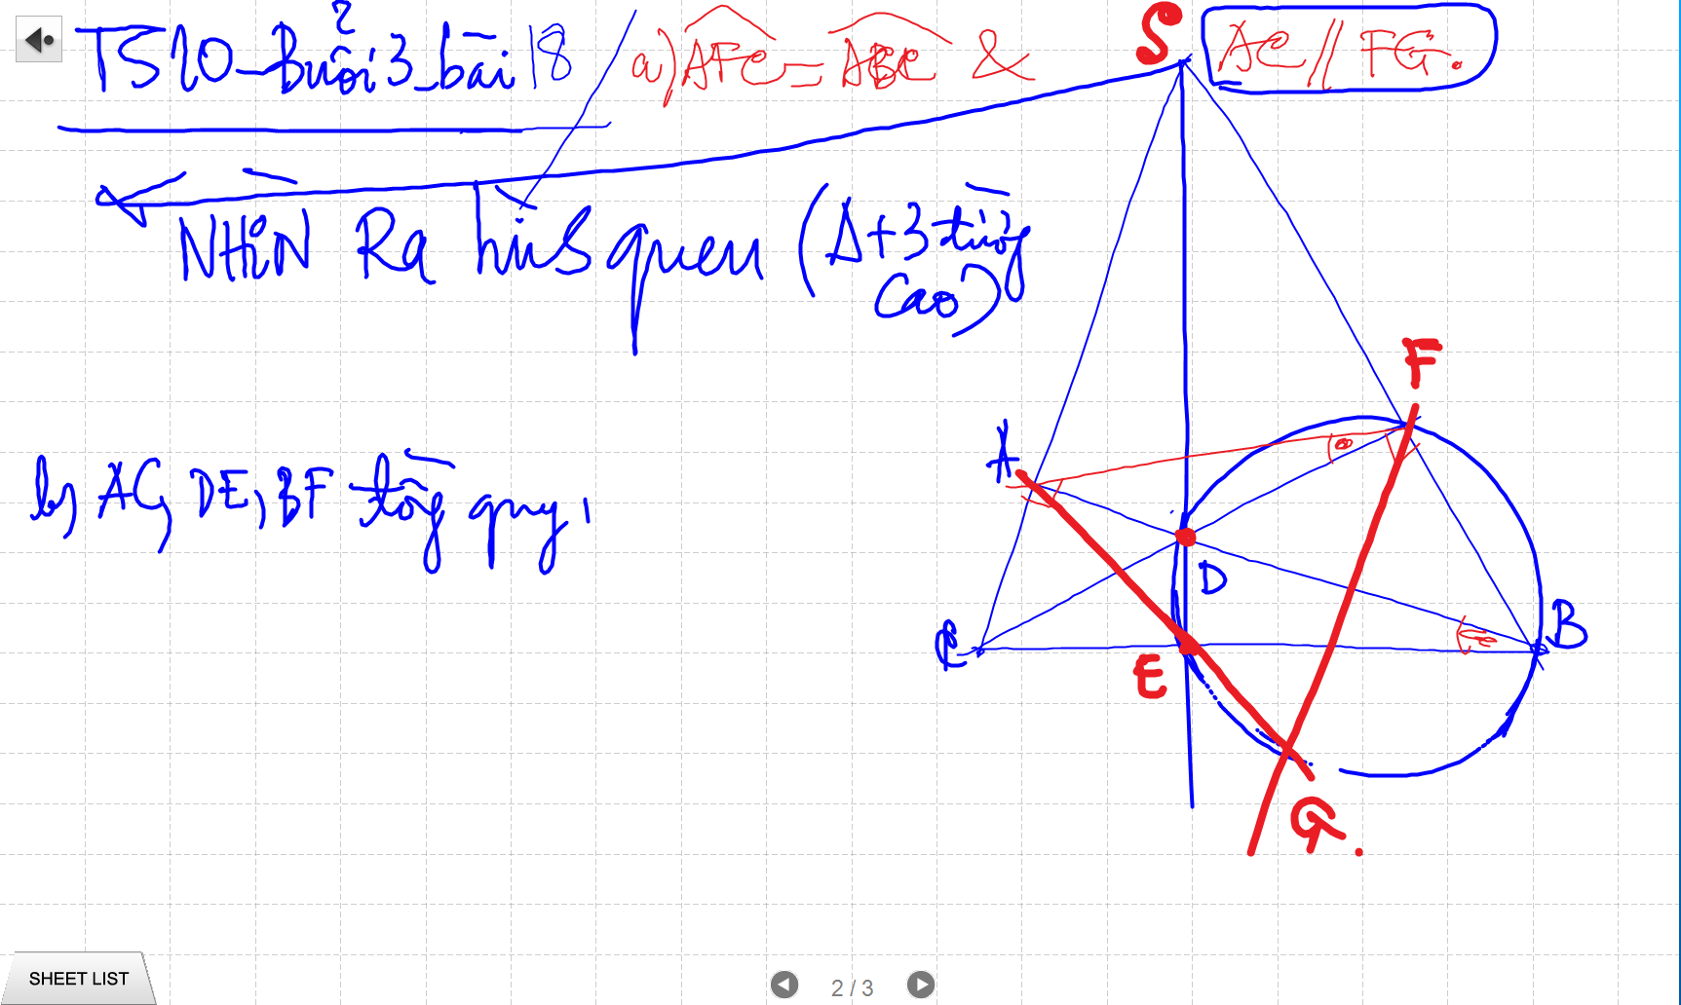
C/m tam giac dong dang truong hop 2

Slide 13
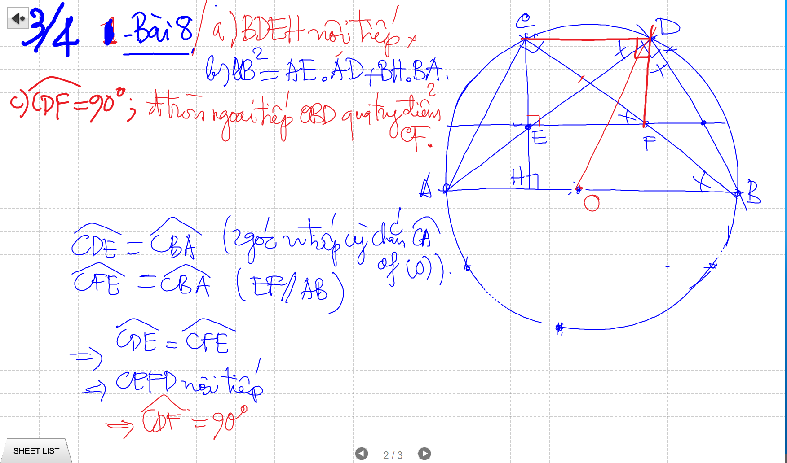
C/m tam giac dong dang truong hop 2

Slide 14
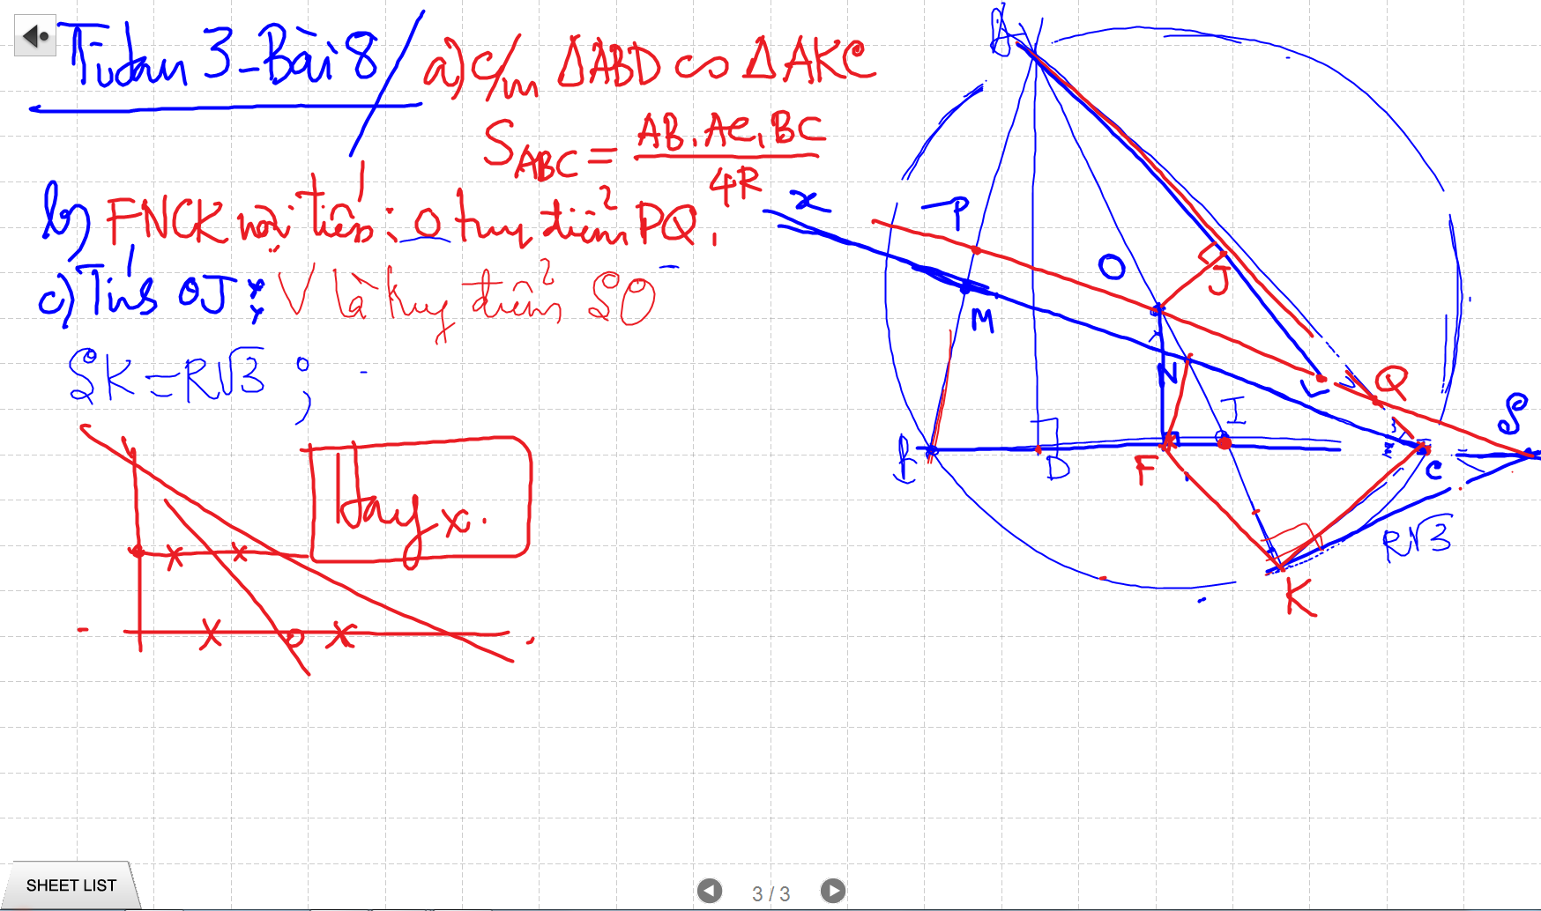
C/m tam giac dong dang truong hop 2

Slide 15
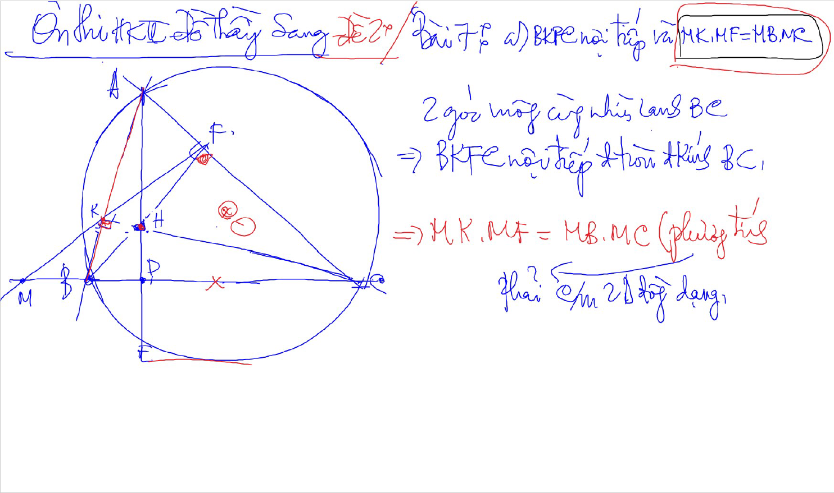
C/m tam giac dong dang truong hop 2

Slide 16
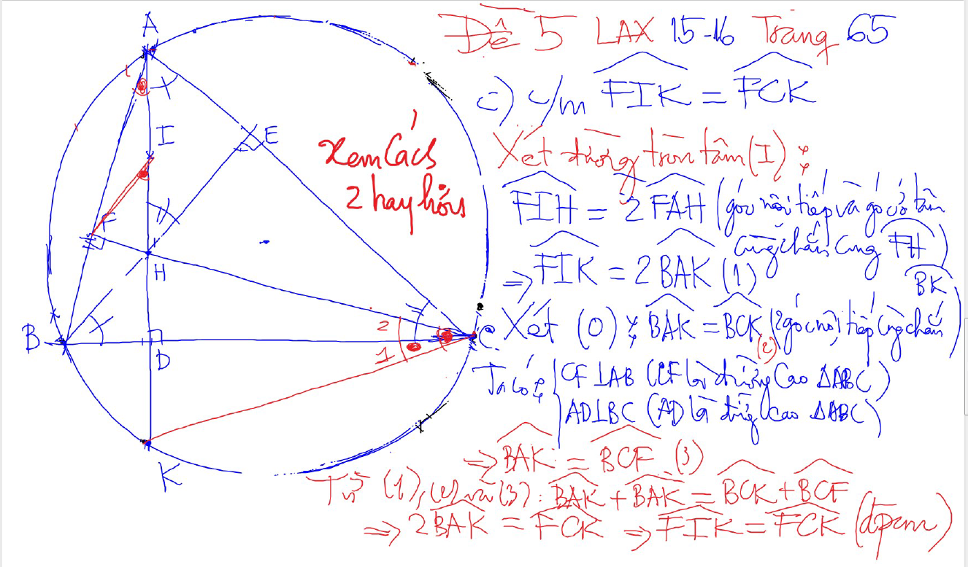
DUONG THANG SIMSON – Ap Dung

Slide 17
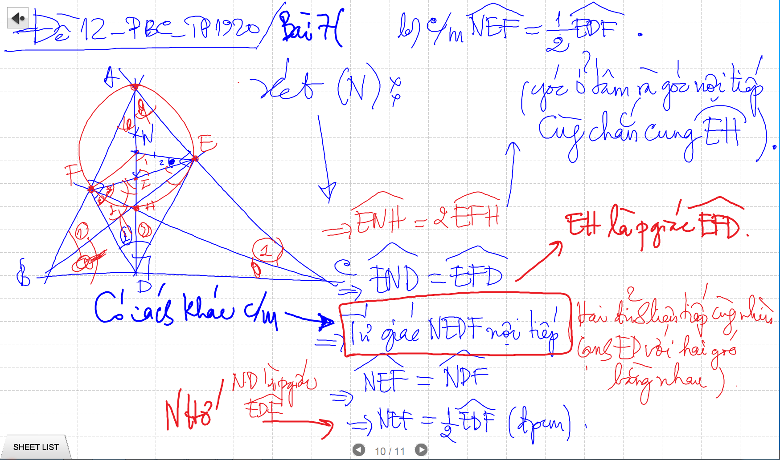
CM TU GIAC NOI TIEP -> SUY RA CAC GOC BANG NHAU

Slide 18
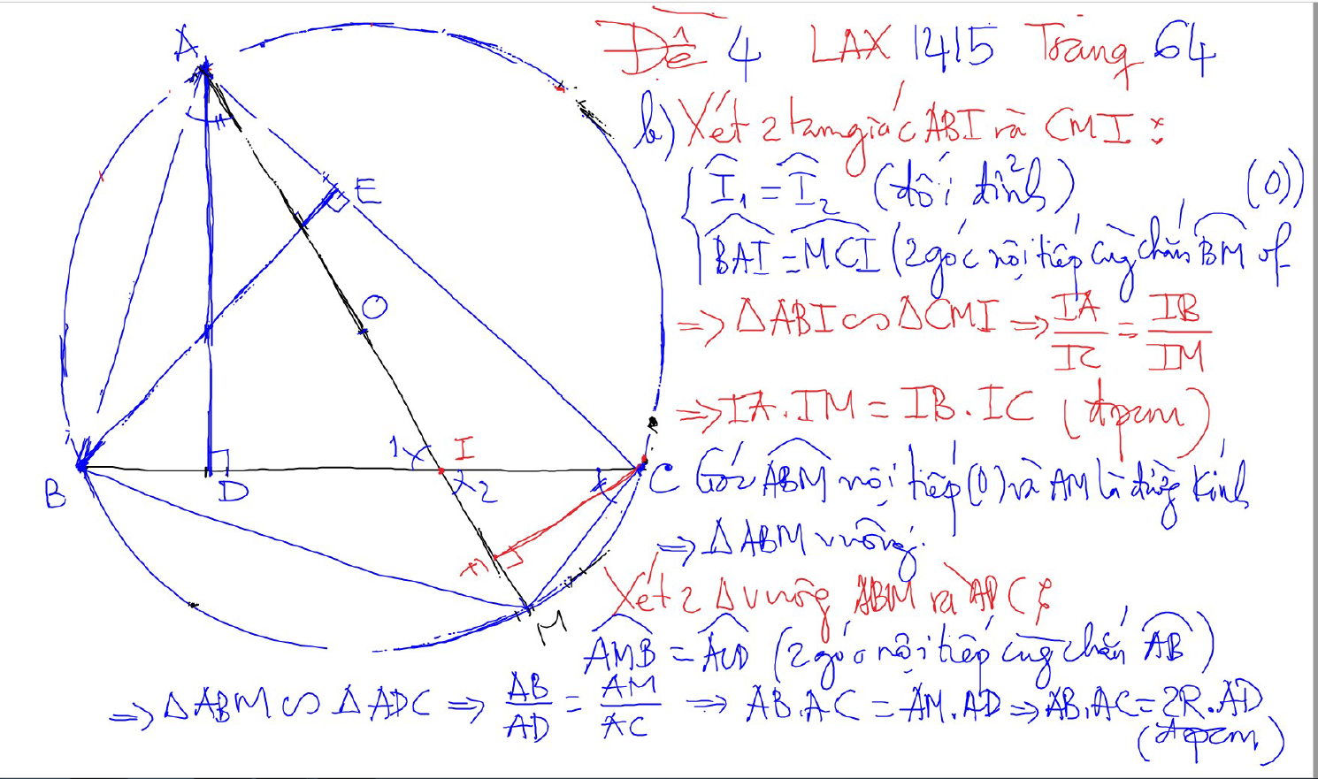
PHUONG TICH DIEM TRONG DUONG TRON

Slide 19
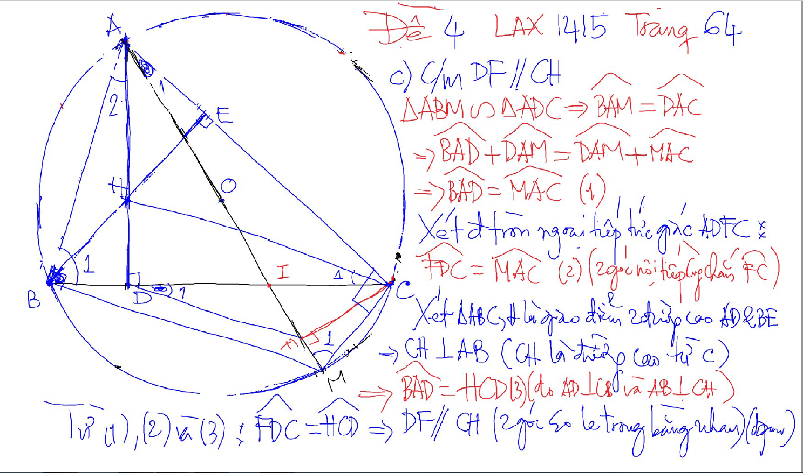
PHUONG TICH DIEM TRONG DUONG TRON

Slide 20
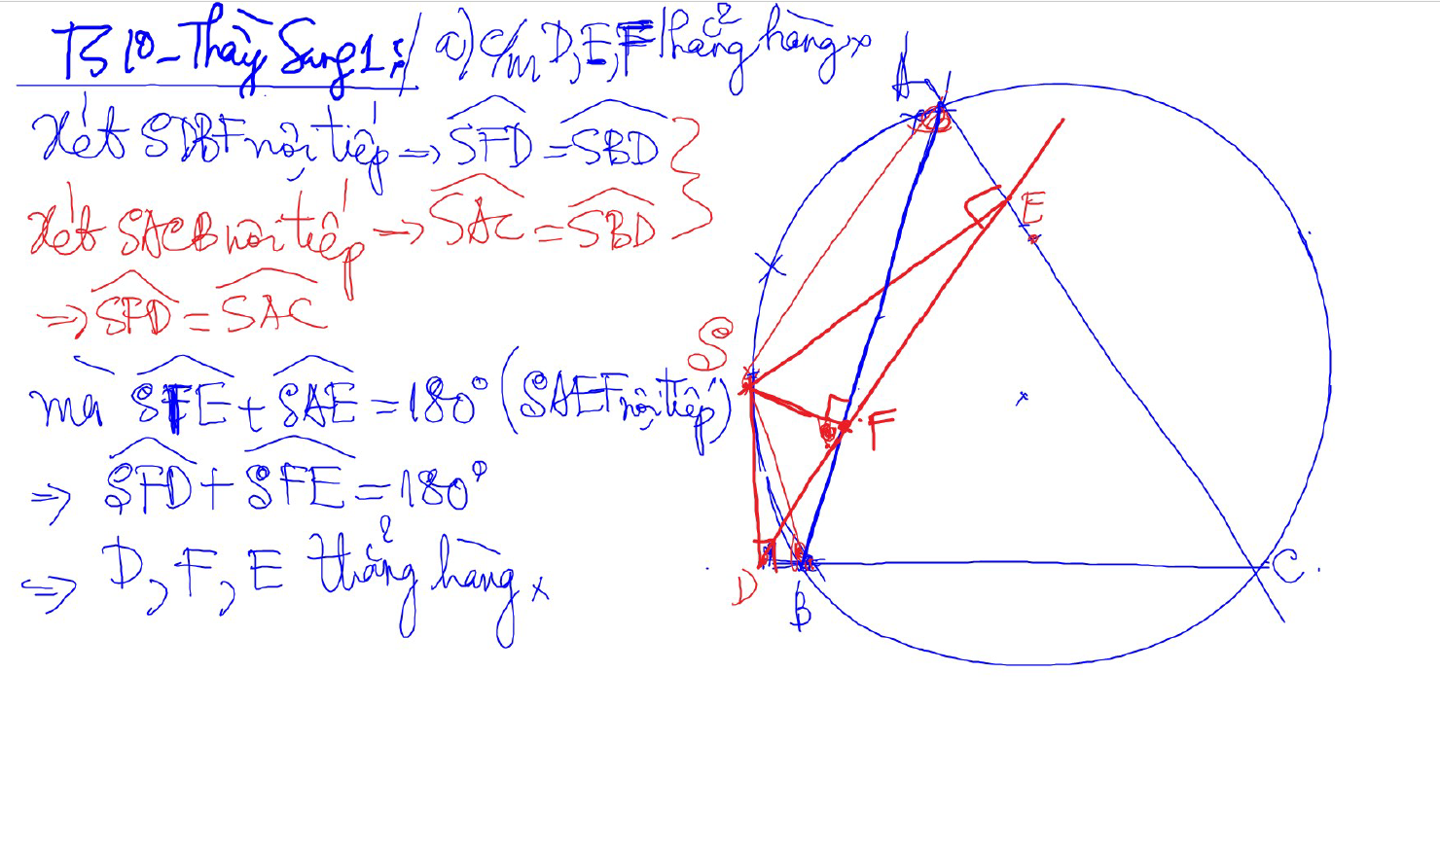
Đường thẳng SIMSON

Slide 21
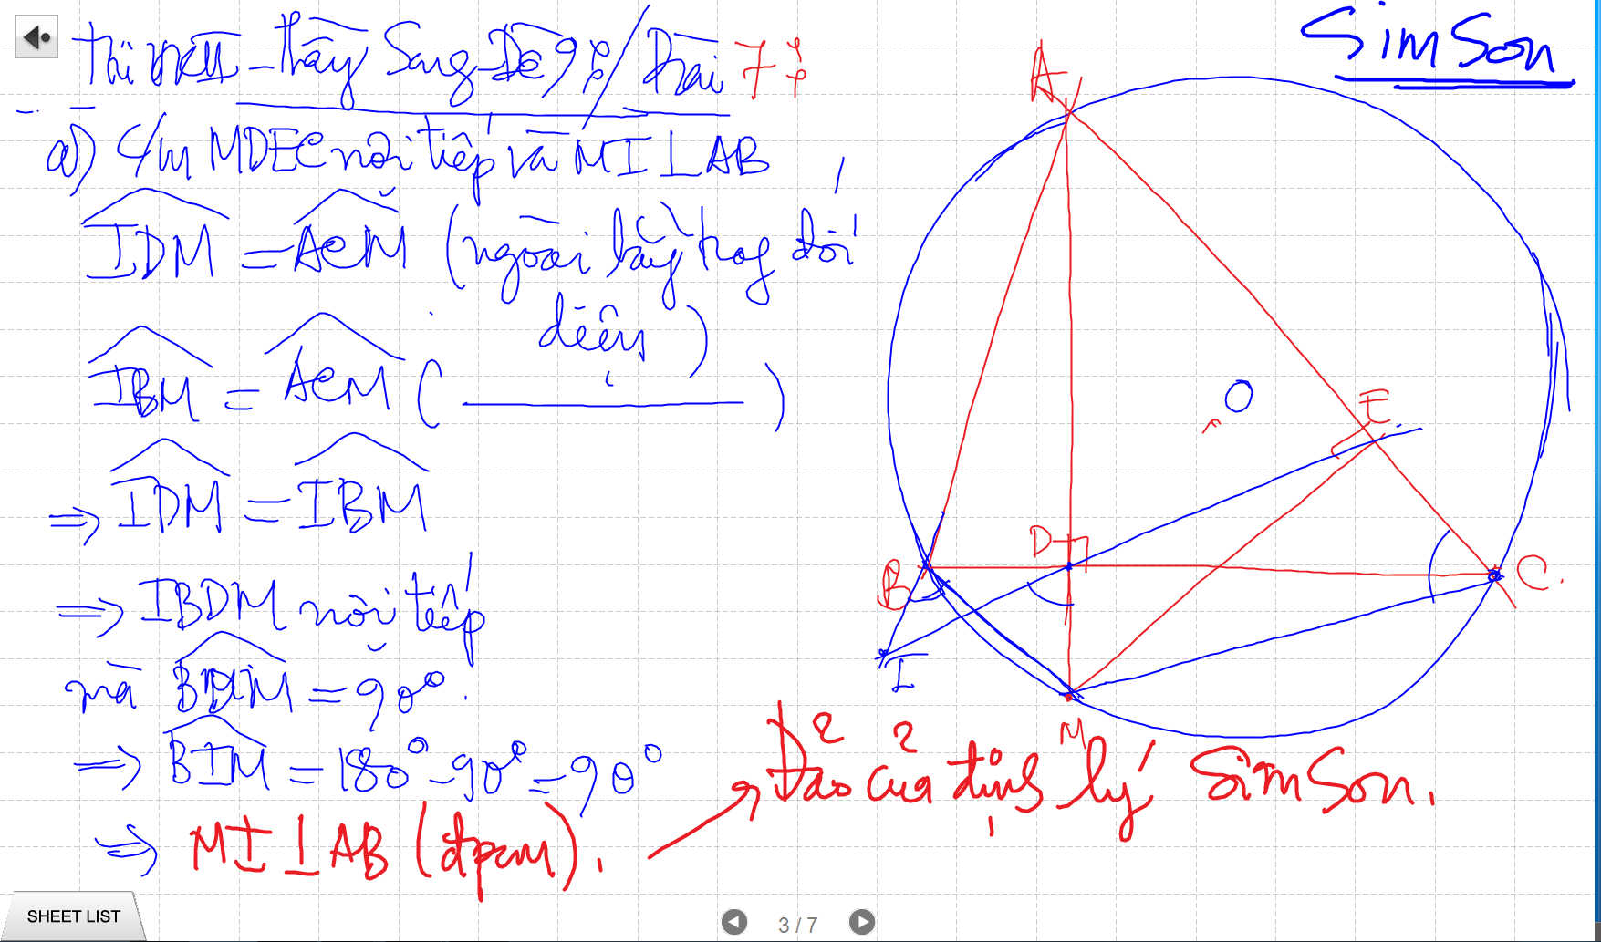
SIMSON

Slide 22
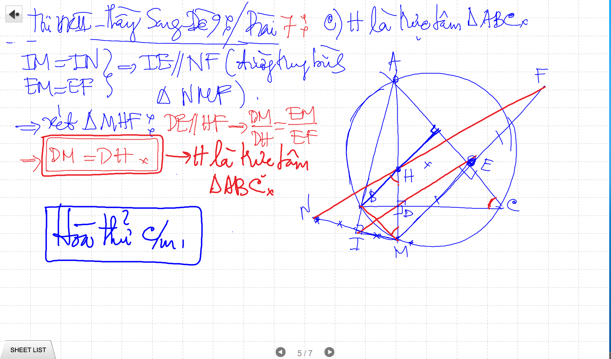
SIMSON

Slide 23
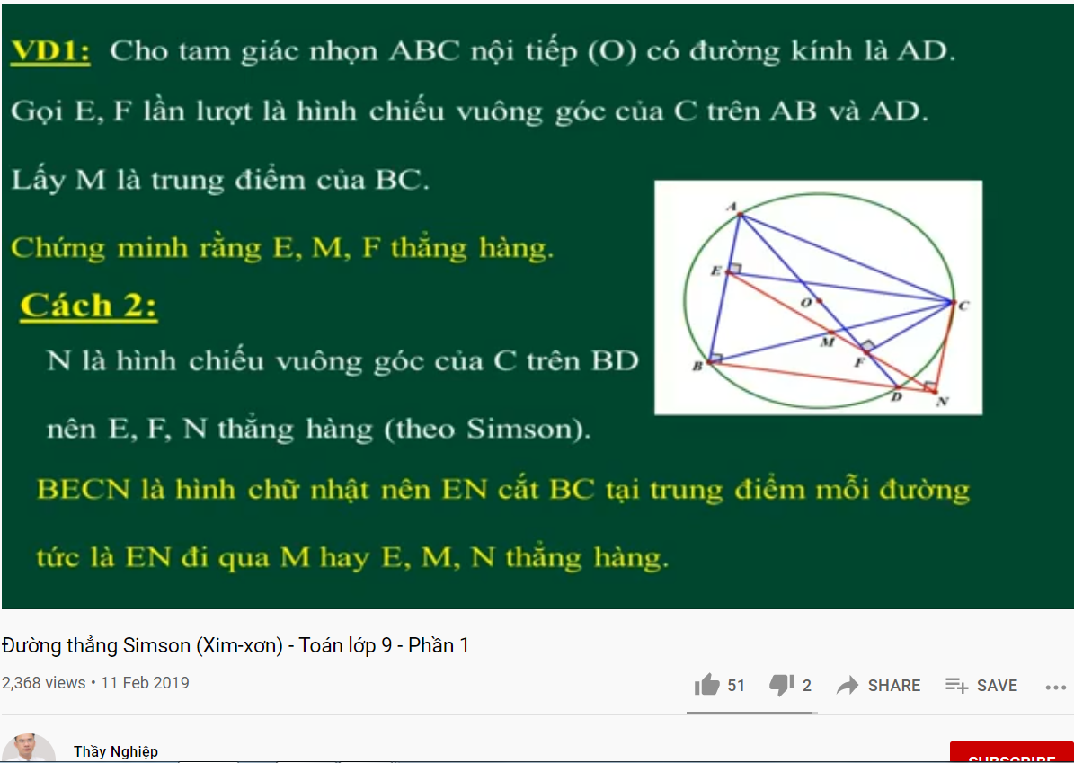
DUONG THANG SIMSON – Ap Dung

Slide 24
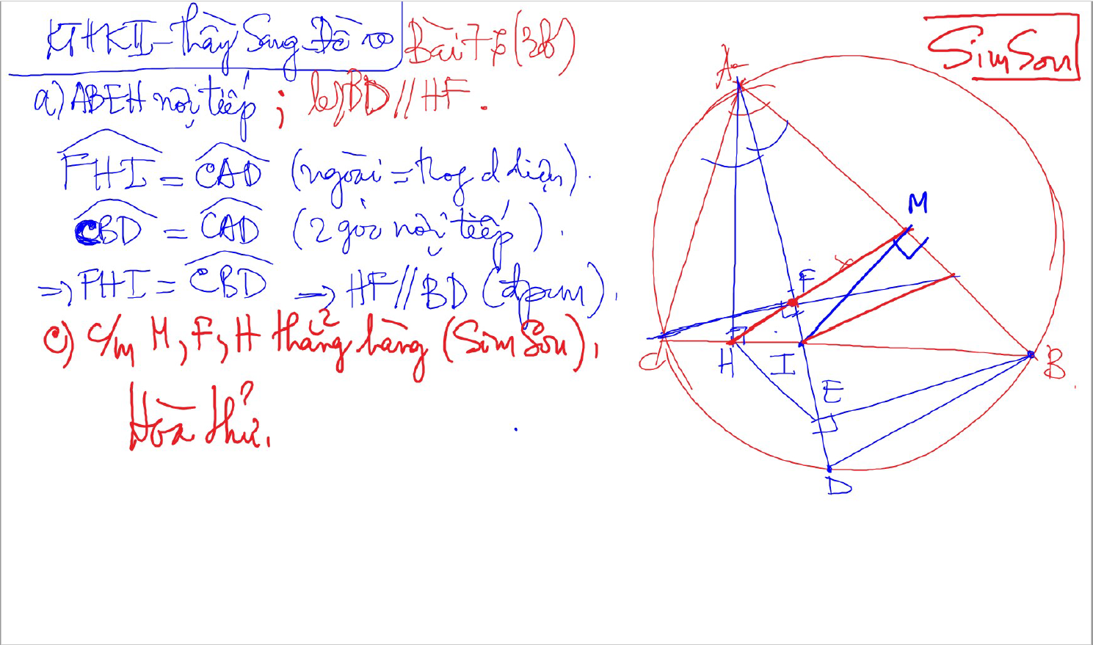
SIMSON

Slide 25
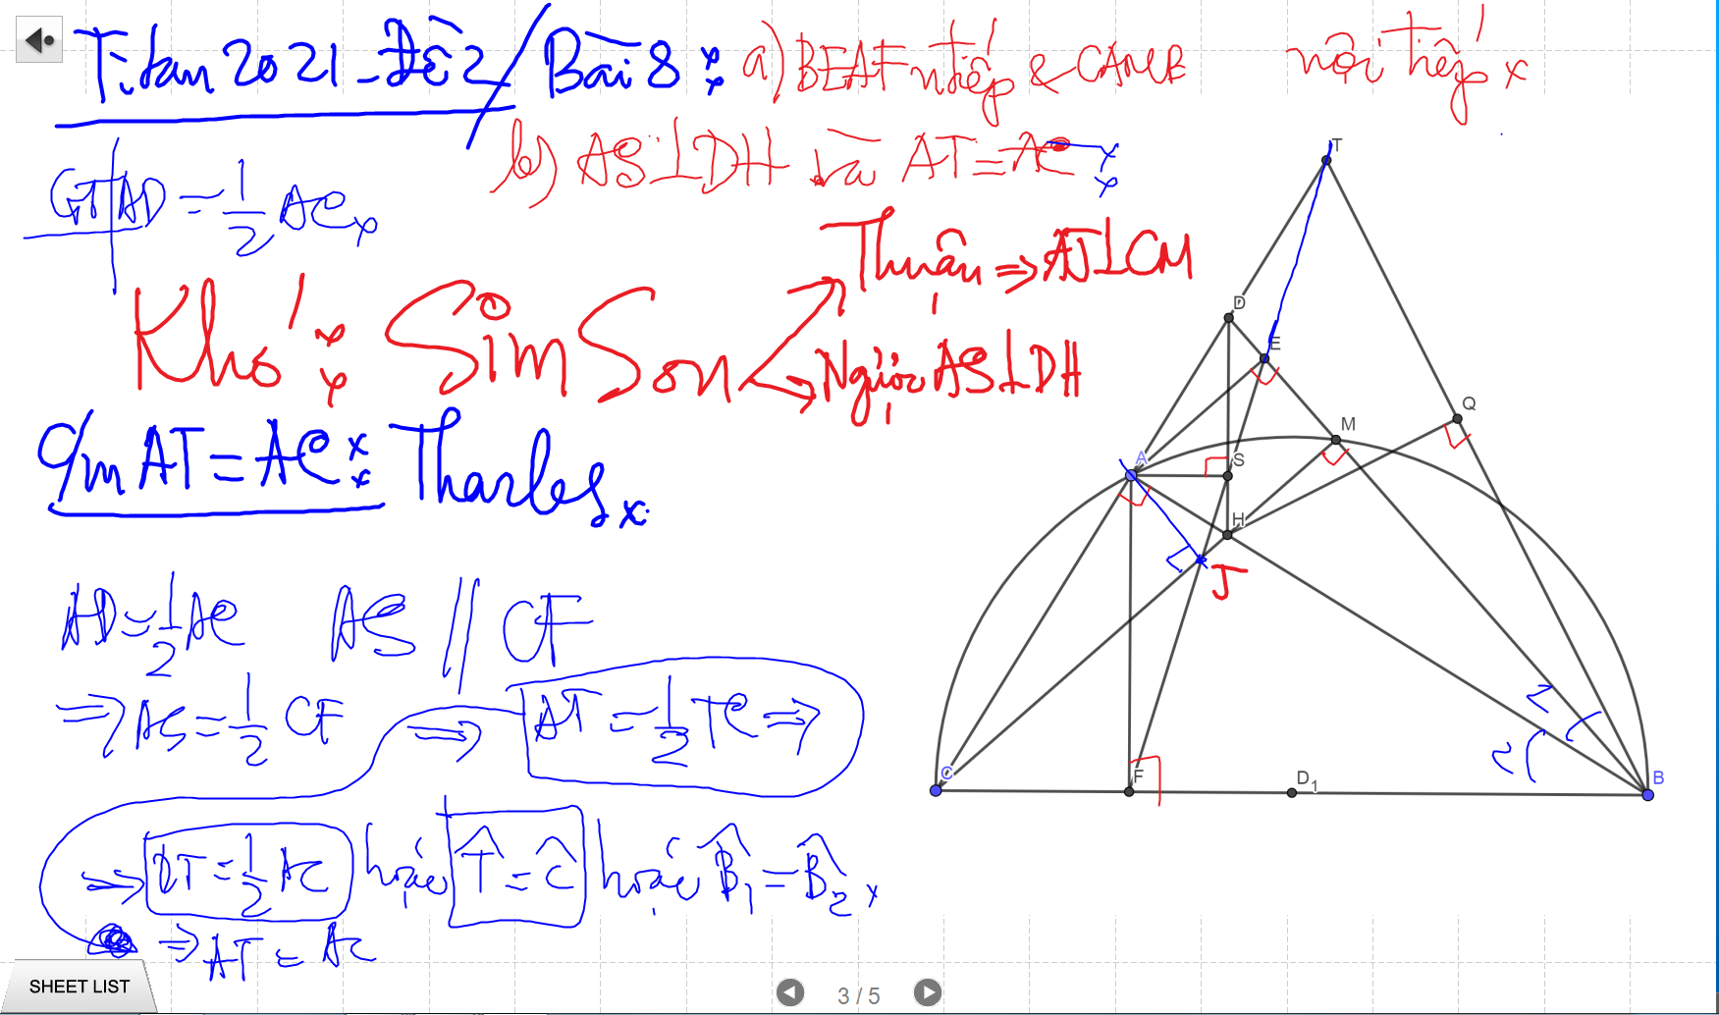
SIMSON

Slide 26
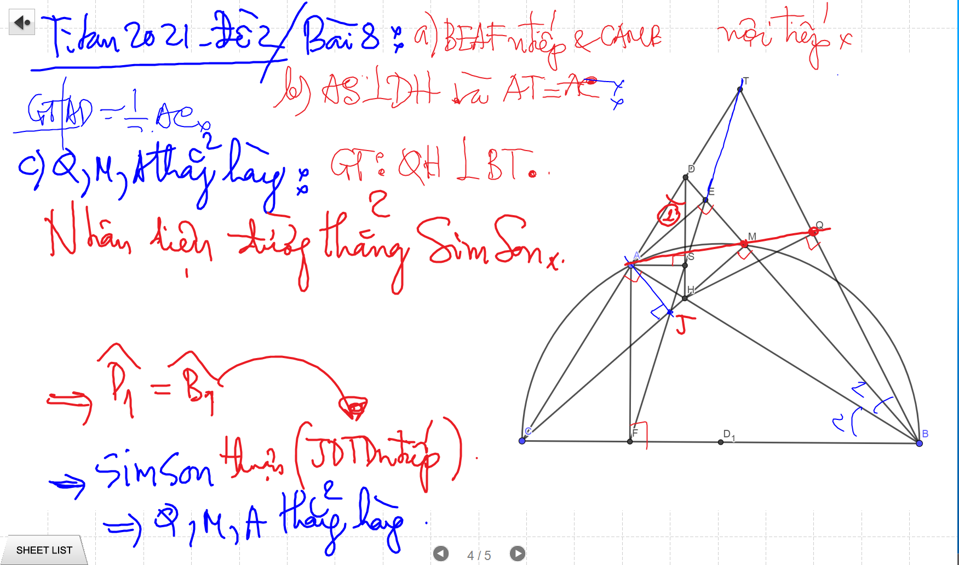
SIMSON

Slide 27
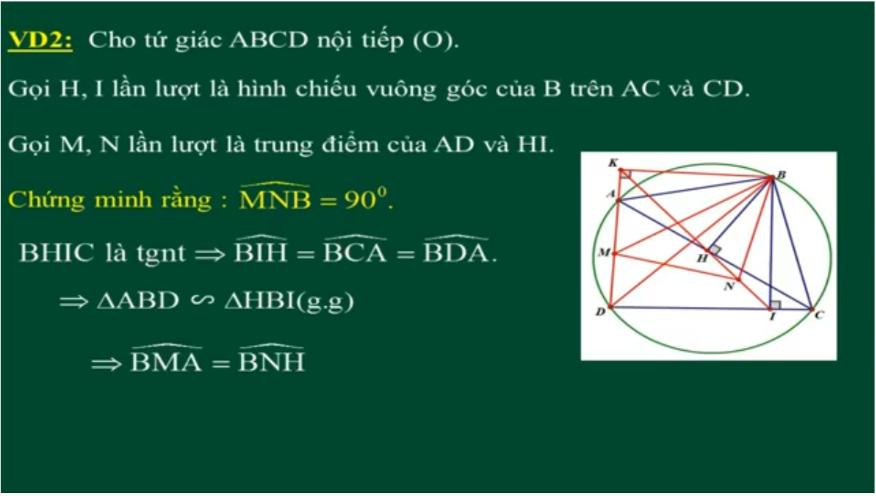
DUONG THANG SIMSON – Ap Dung

Slide 28
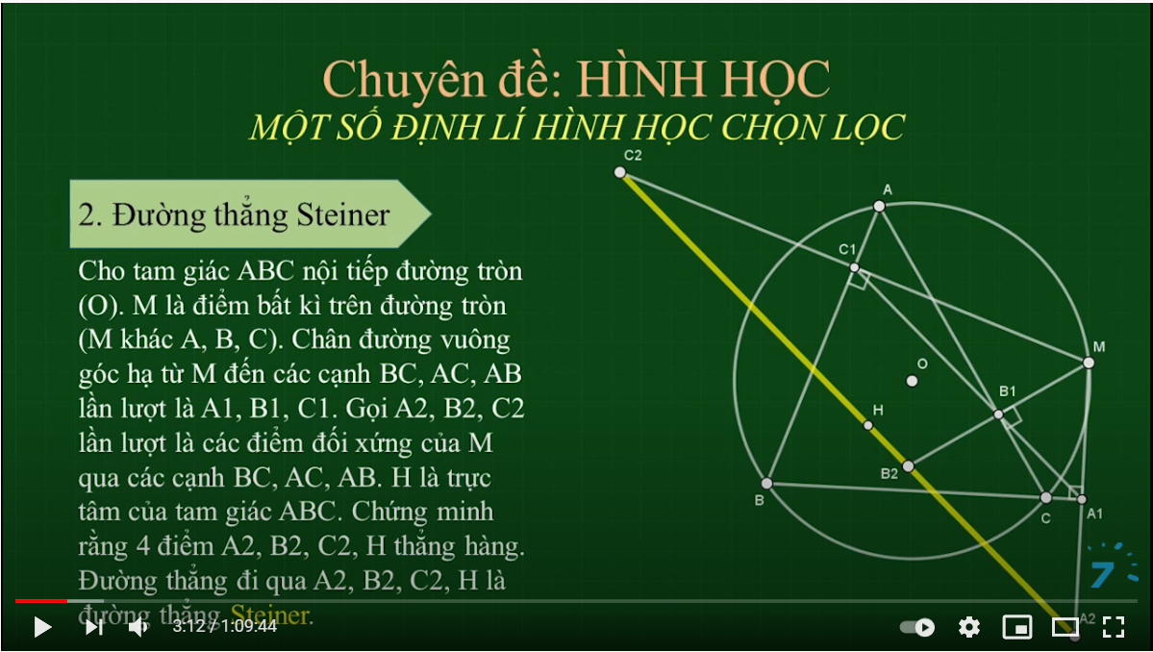
SIMSON

Slide 29
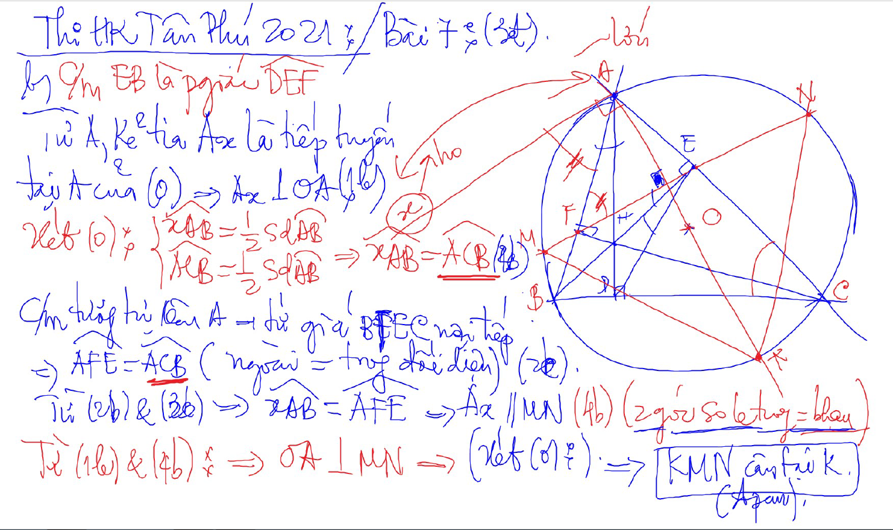
C/m tam giac dong dang truong hop 2

Slide 30
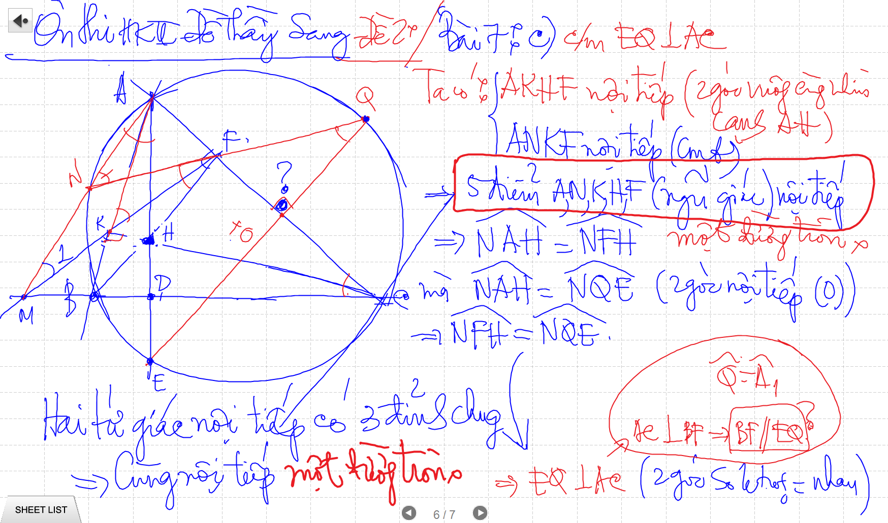

Slide 31
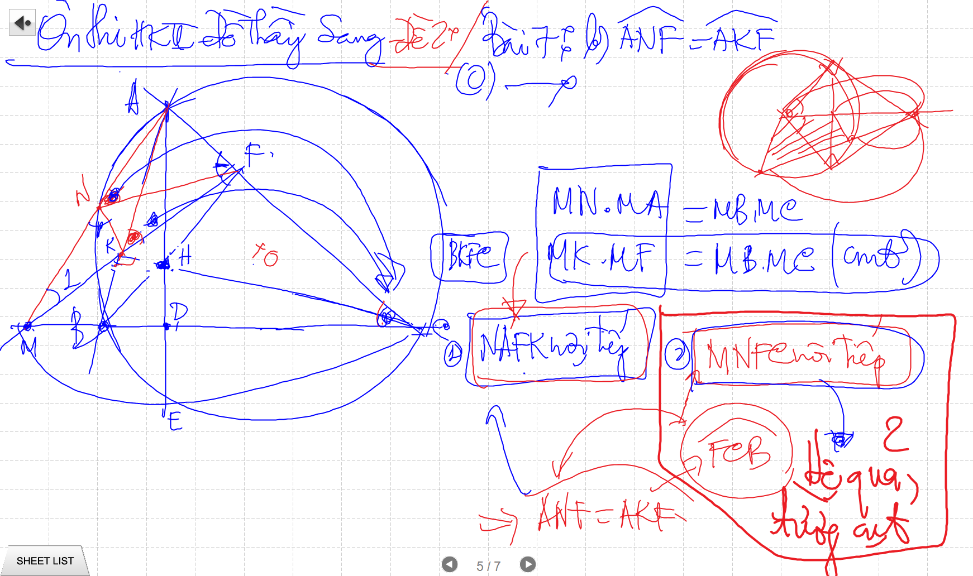
C/m tam giac dong dang truong hop 2

Slide 32
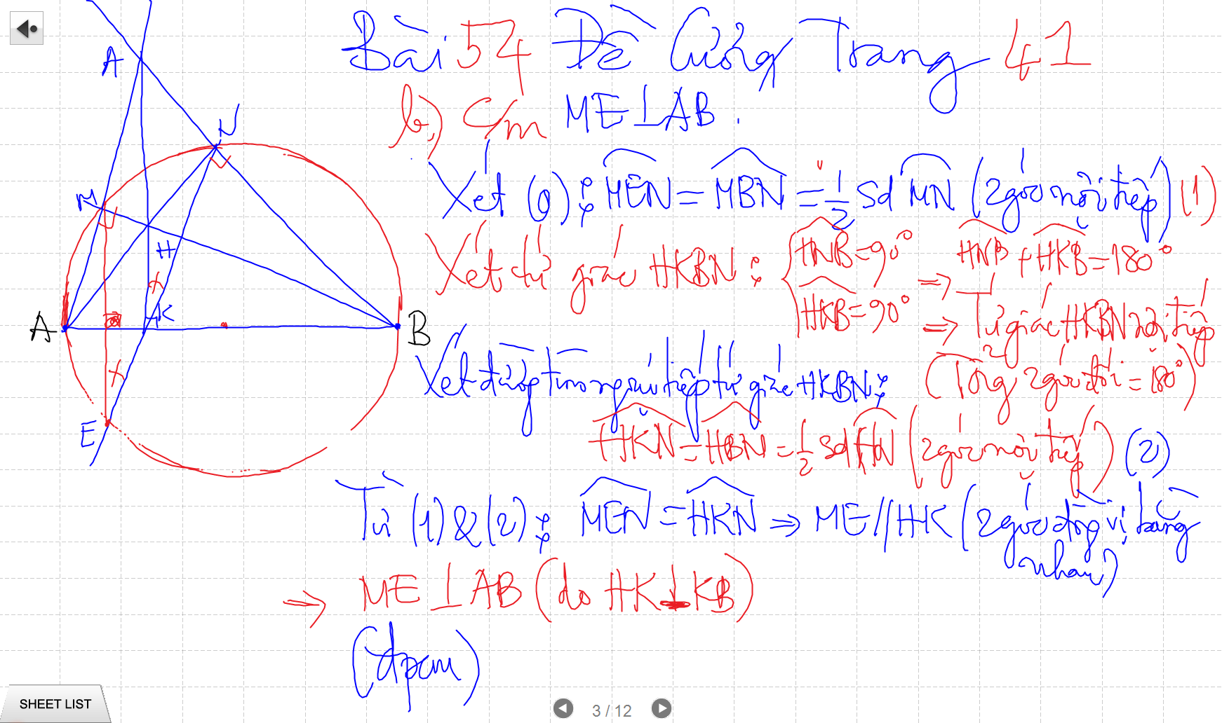

Slide 33
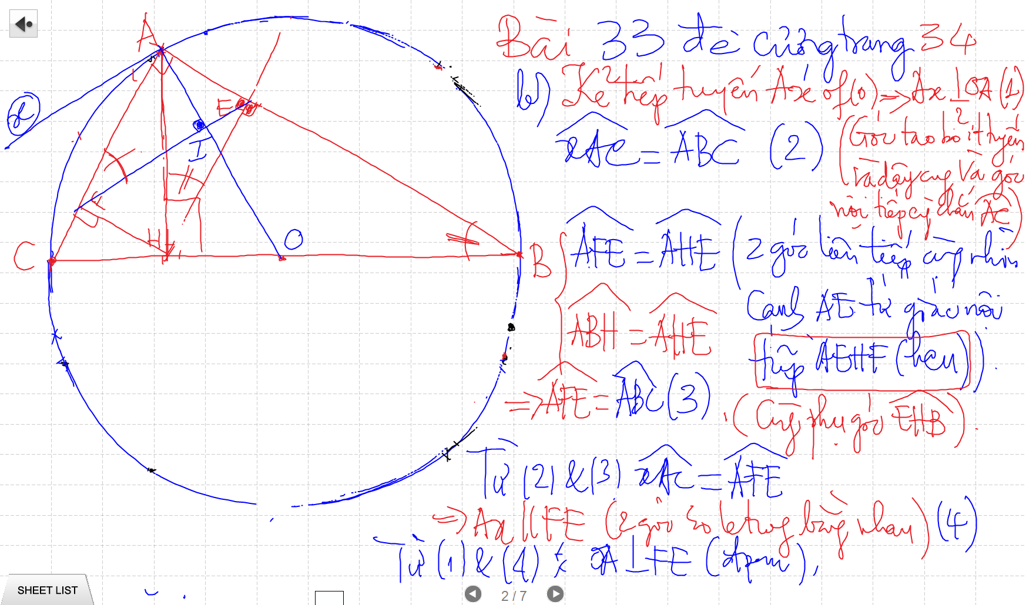
C/m tam giac dong dang truong hop 2

Slide 34
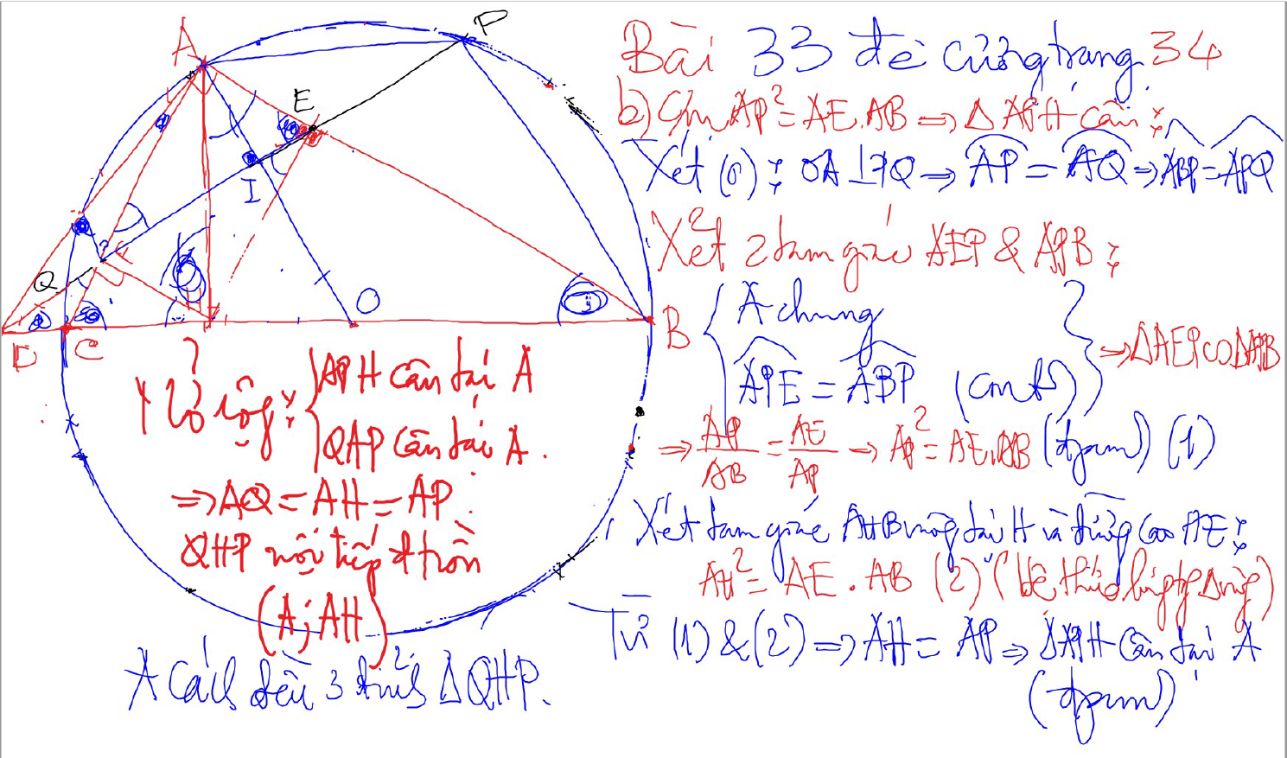
Bai 53 De Cuong – Kinh dien tam giac nhon 1 (xem trong thu muc Tu Giac Noi Tiep)

Slide 35
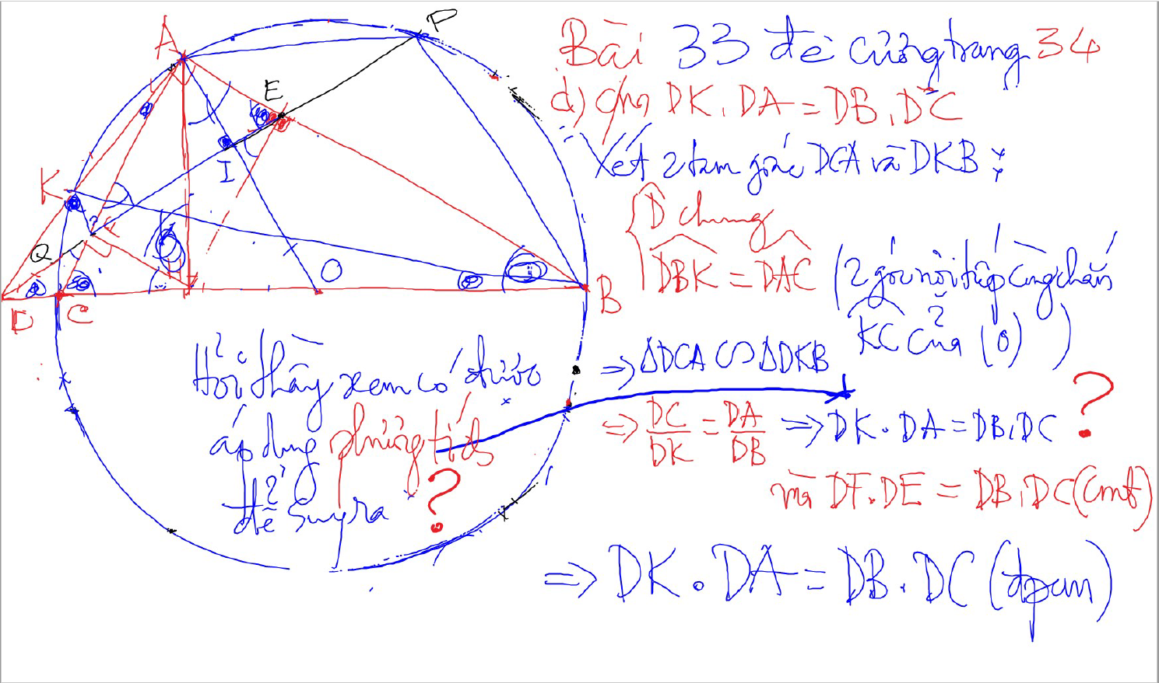
C/m tam giac dong dang truong hop 2

Slide 36
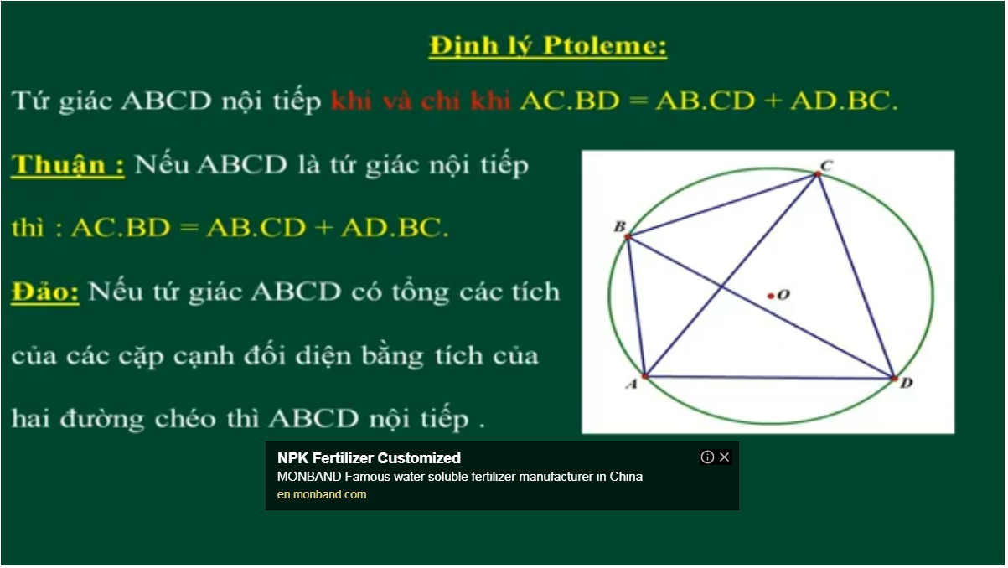
Bai 54 De Cuong – Kinh dien tam giac nhon 1 (xem trong thu muc Tu Giac Noi Tiep)

Slide 37
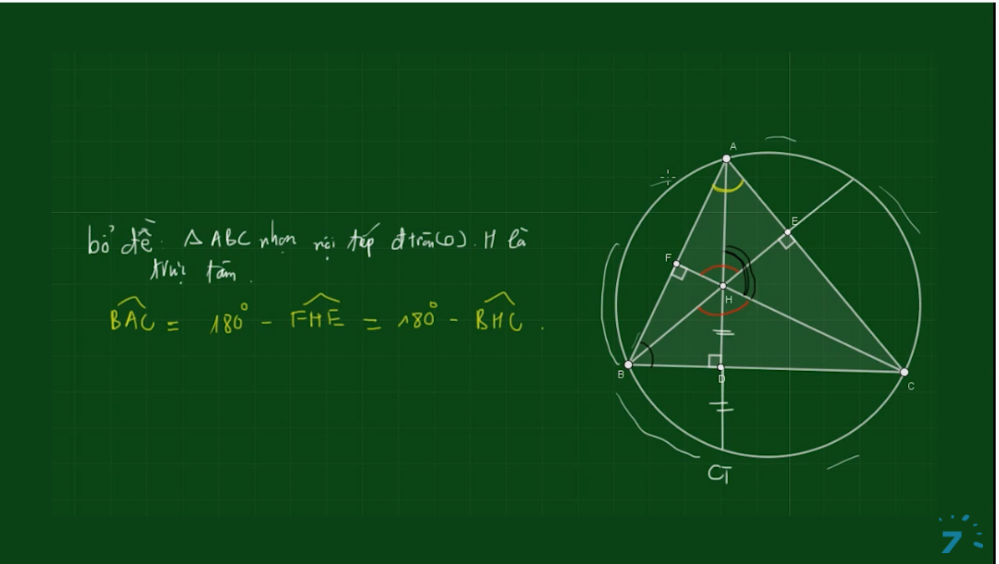
Bai 54 De Cuong – Kinh dien tam giac nhon 1 (xem trong thu muc Tu Giac Noi Tiep)

Slide 38
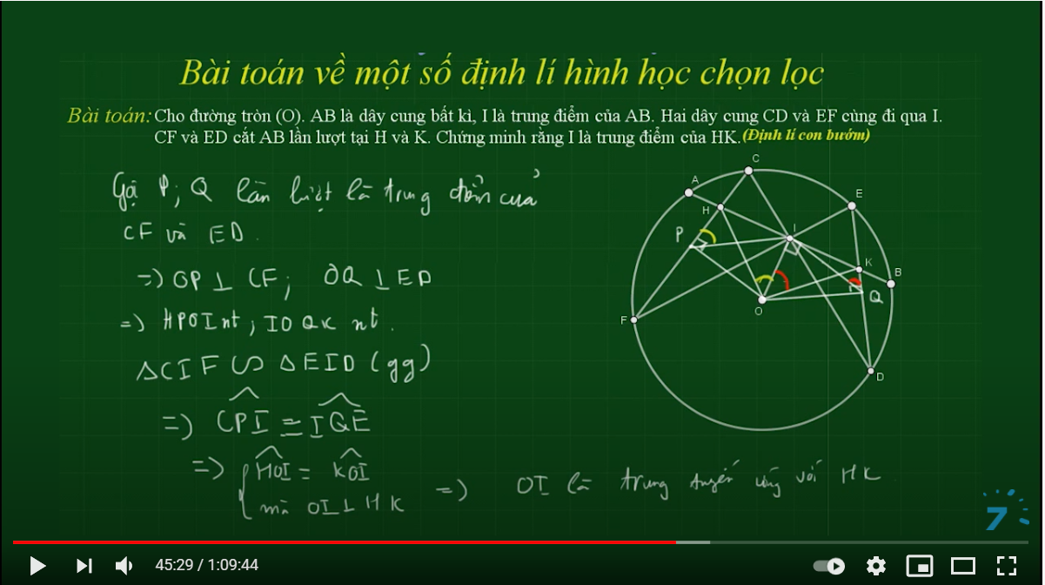

Slide 39
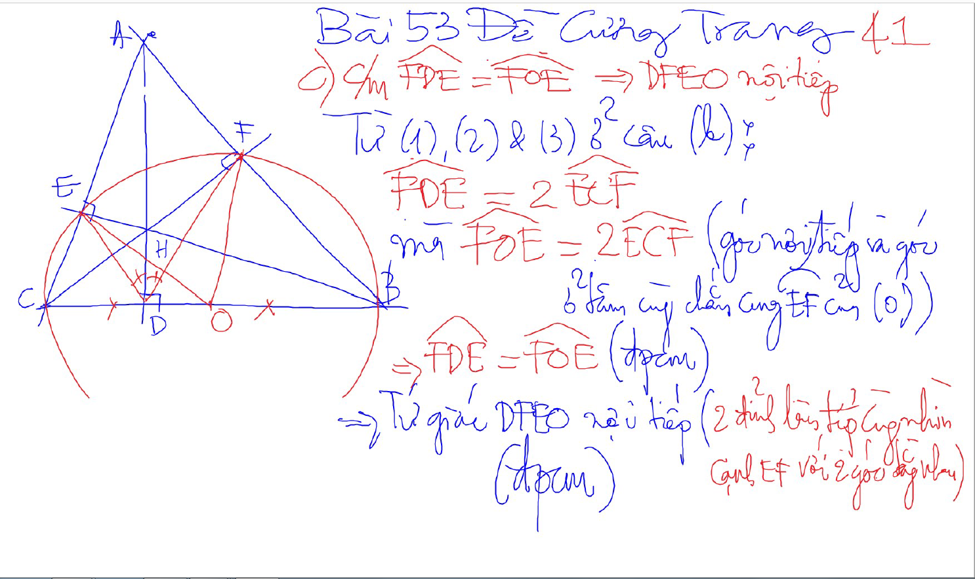
Bai 53 De Cuong – Kinh dien tam giac nhon 1 (xem trong thu muc Tu Giac Noi Tiep)

Slide 40
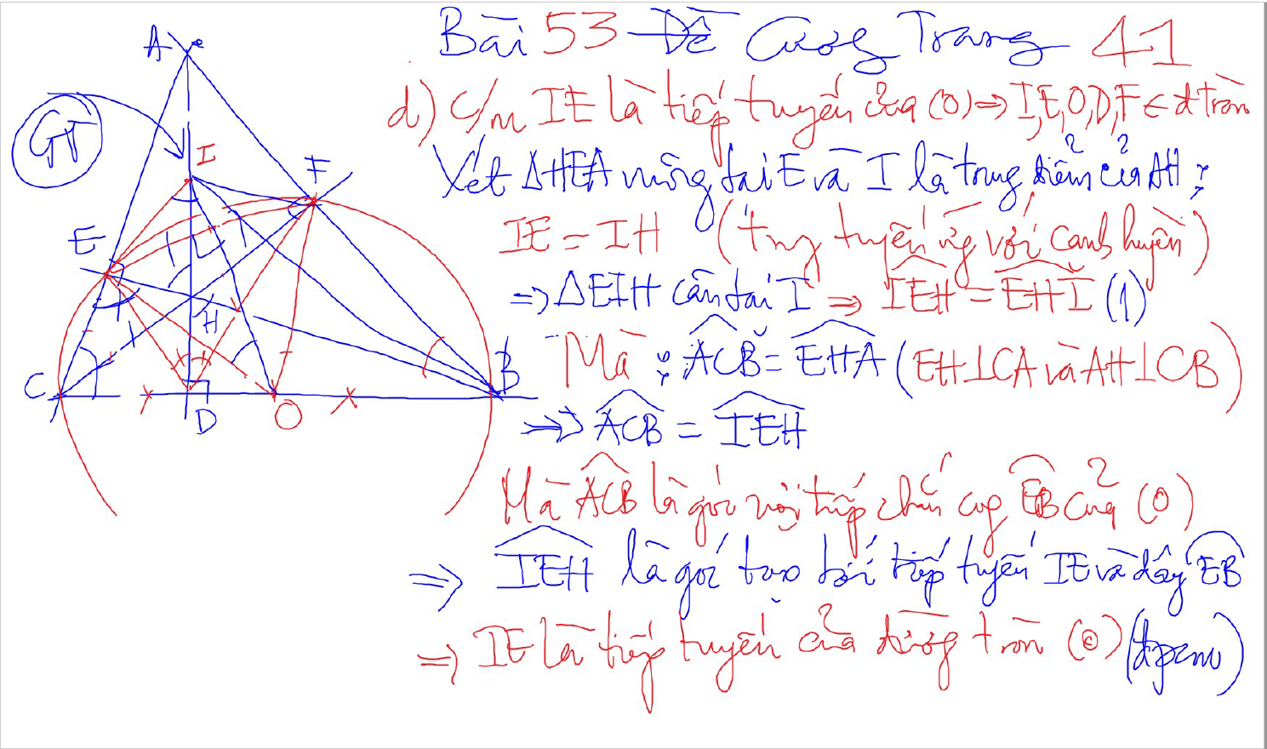
Bai 53 De Cuong – Kinh dien tam giac nhon 1 (xem trong thu muc Tu Giac Noi Tiep)

Slide 41
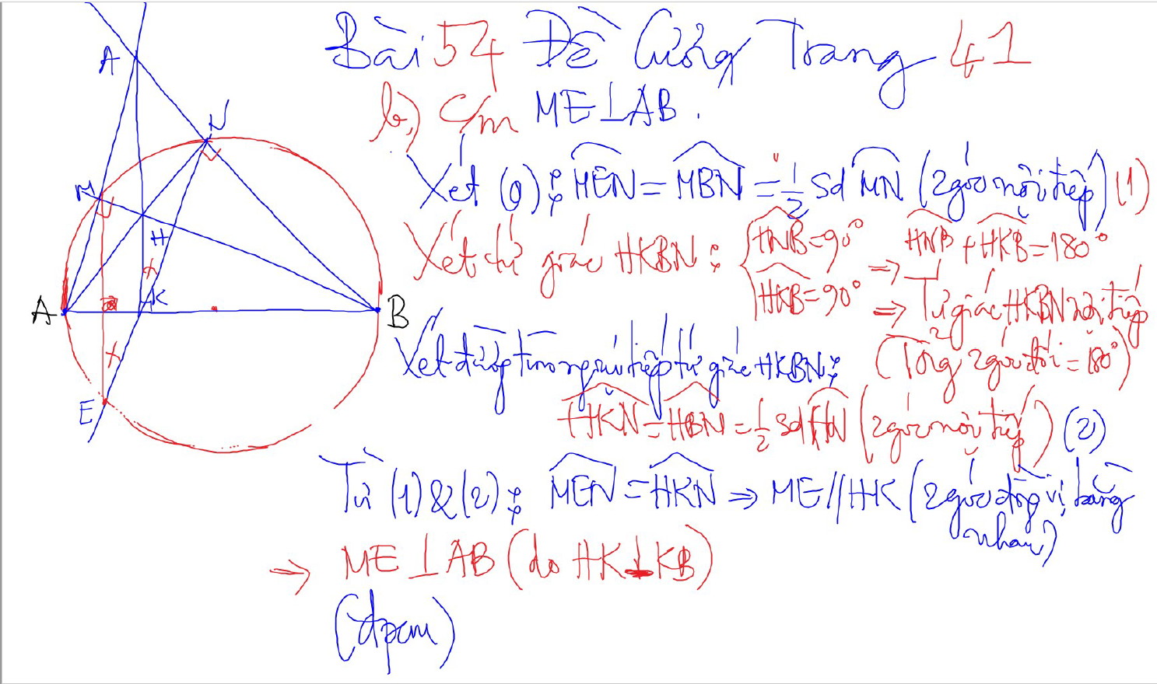
Bai 54 De Cuong – Kinh dien tam giac nhon 1 (xem trong thu muc Tu Giac Noi Tiep)

Slide 42
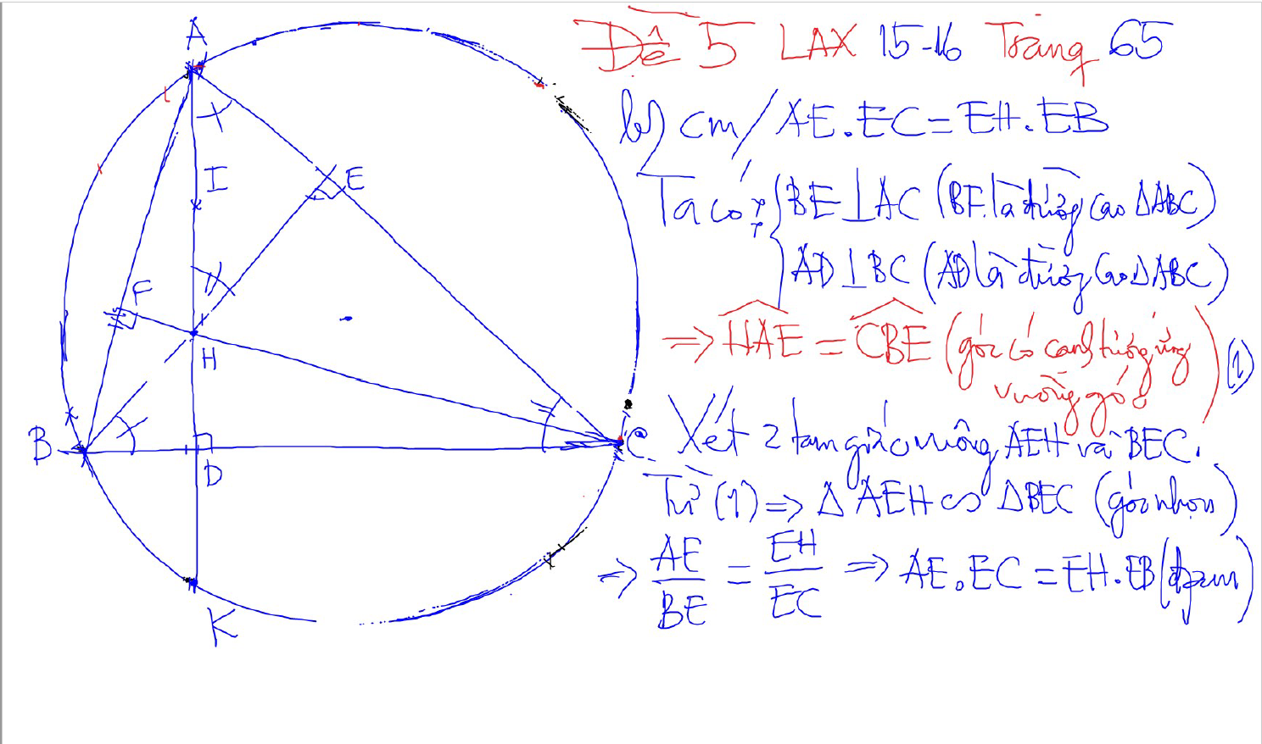
2 tam giac dong dang (truong hop 1)
2 goc bang nhau
1 goc nhon bang nhau

Slide 43
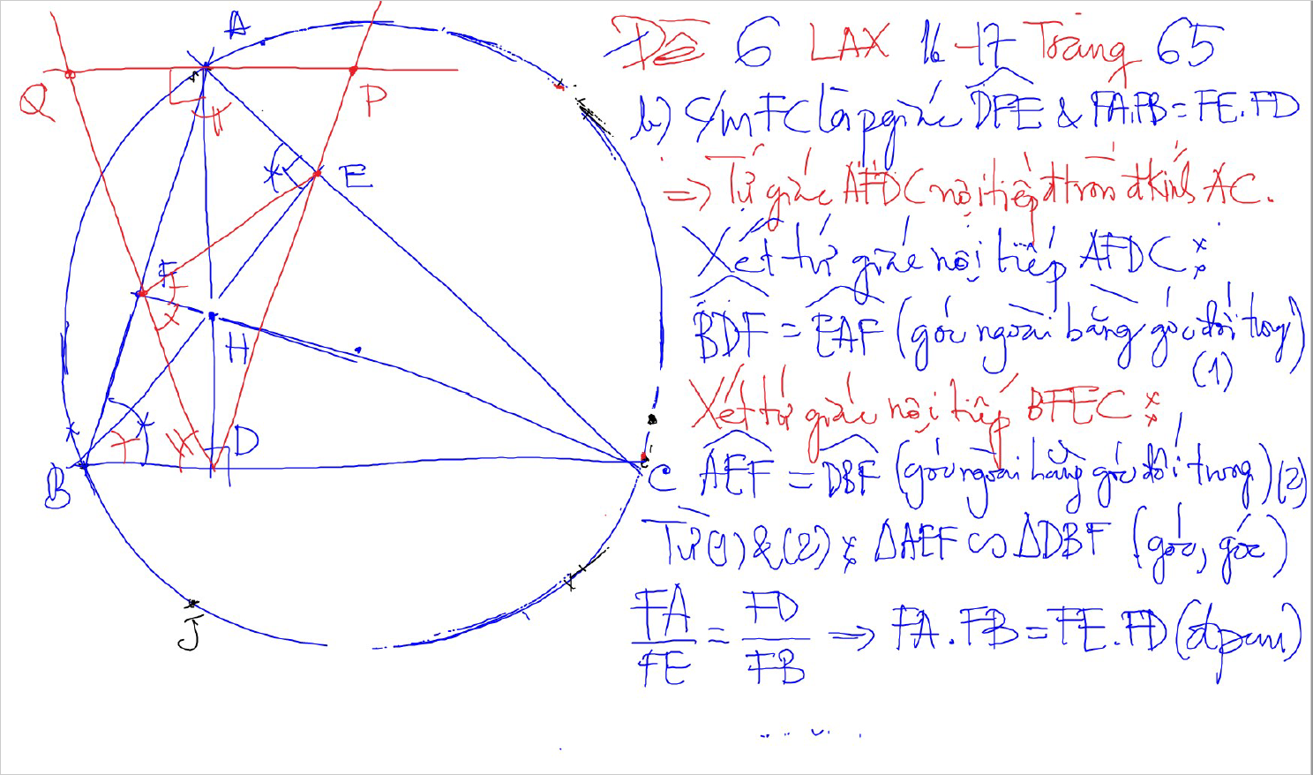
2 tam giac dong dang (truong hop 1)
2 goc bang nhau
1 goc nhon bang nhau

Slide 44
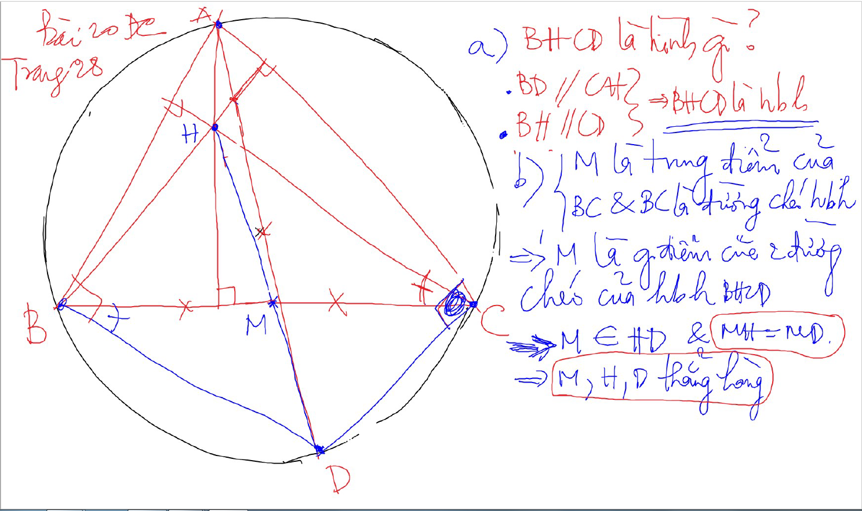

Slide 45
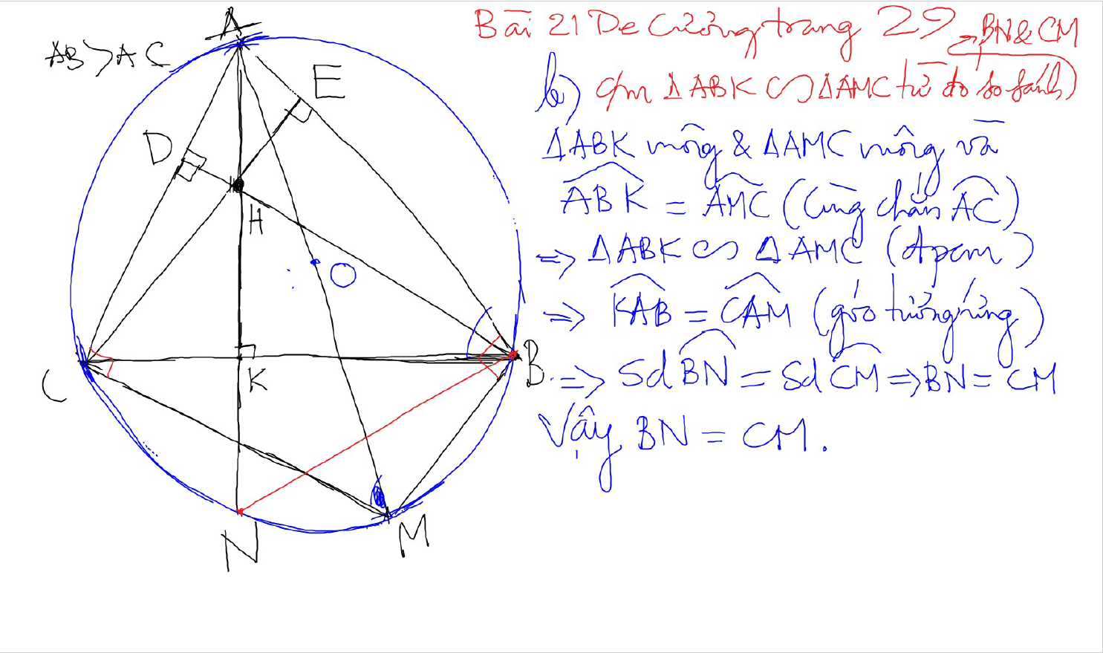

Slide 46
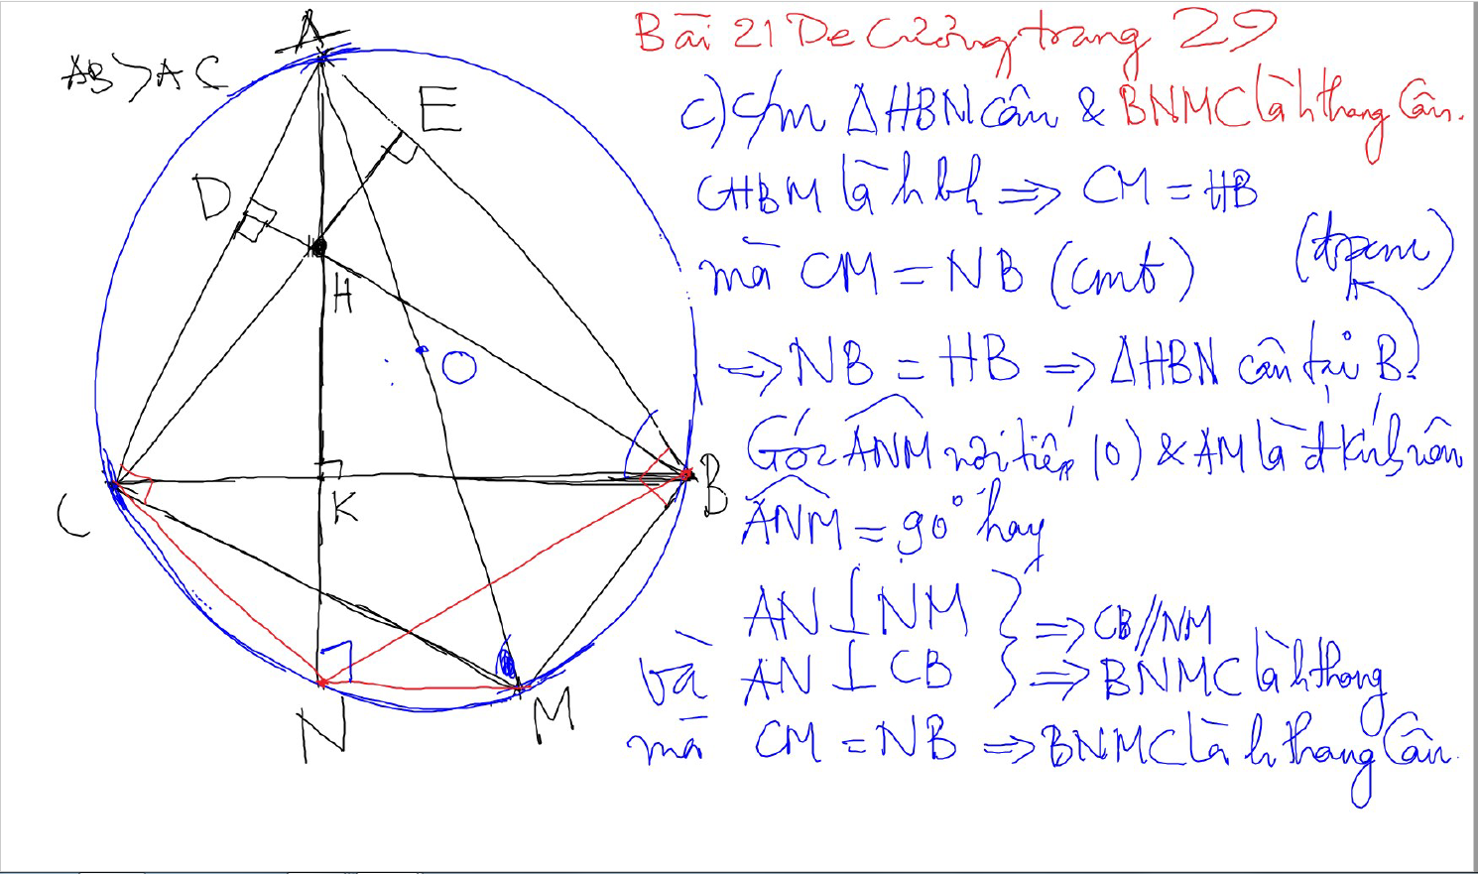

Slide 47
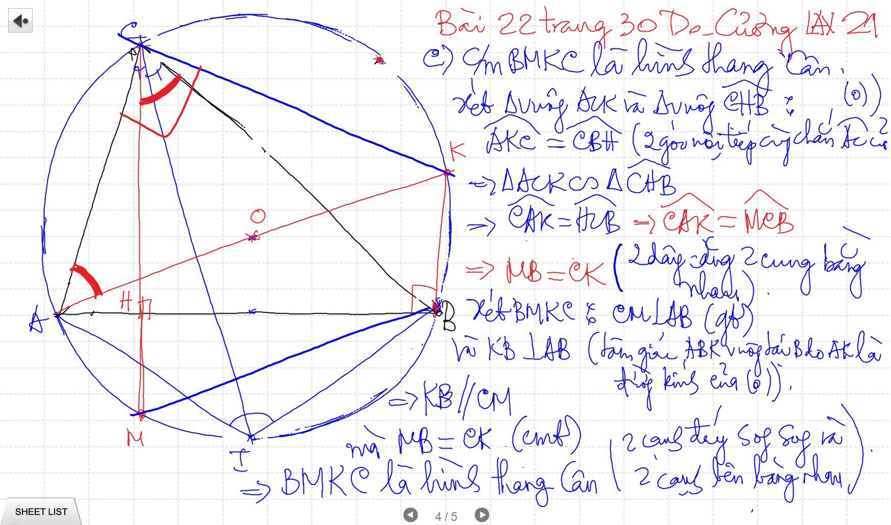

Slide 48
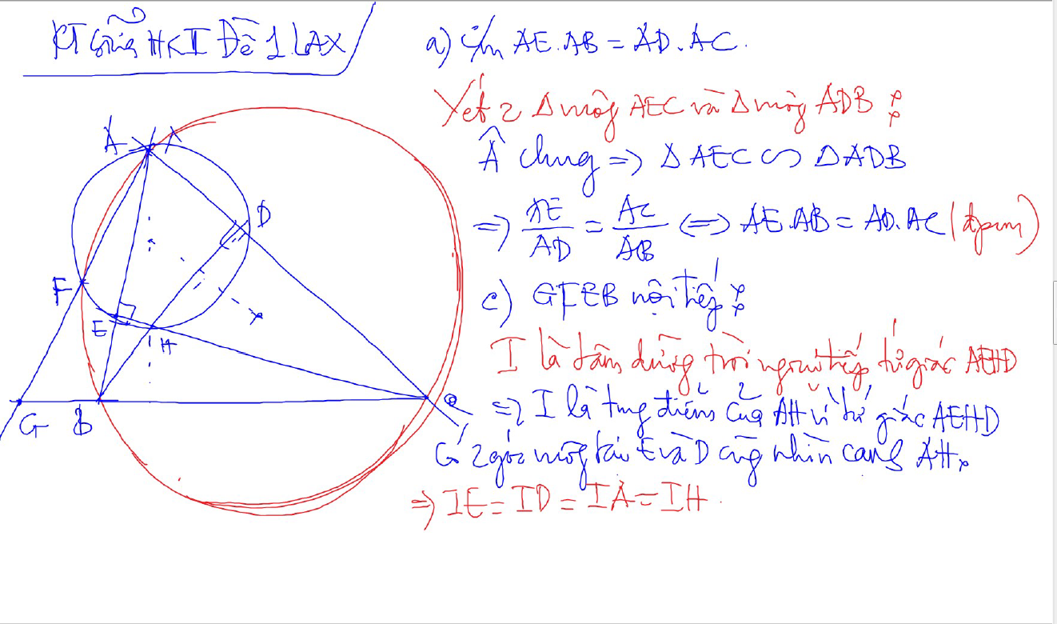

Slide 49
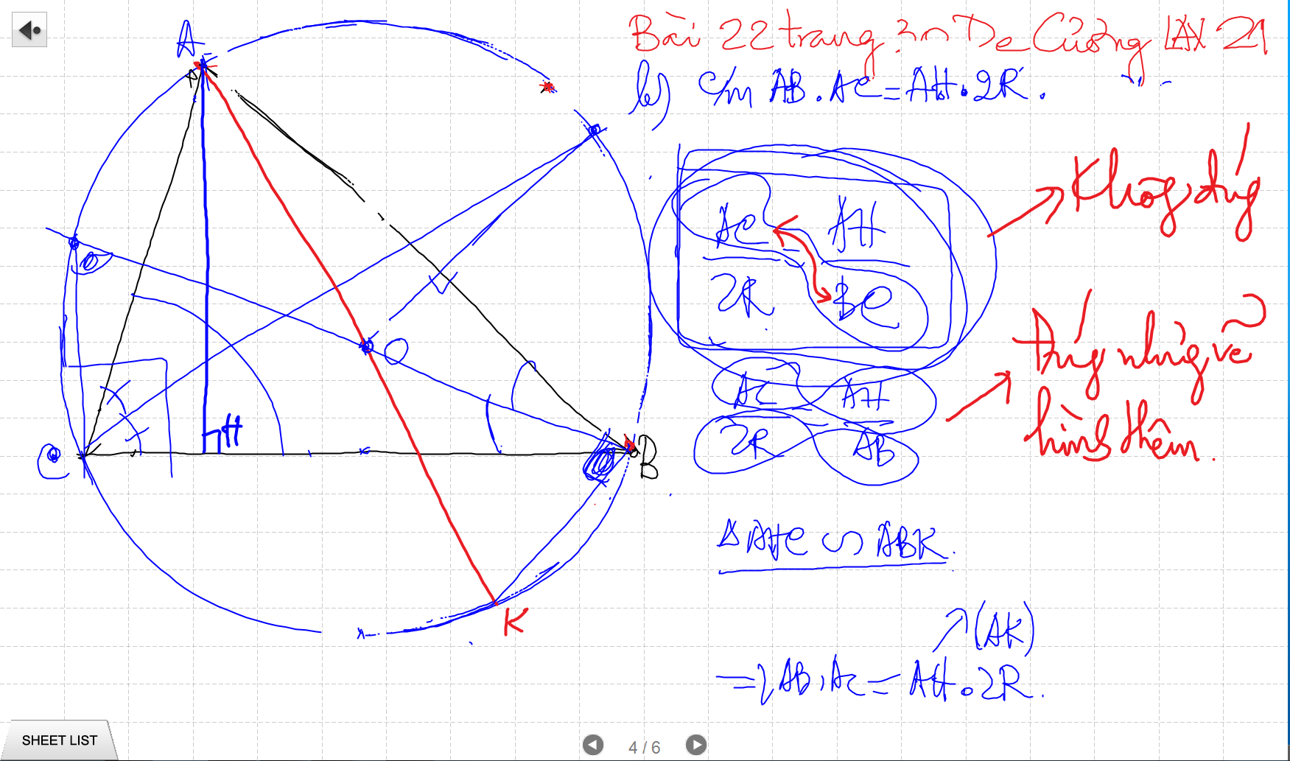

Slide 50
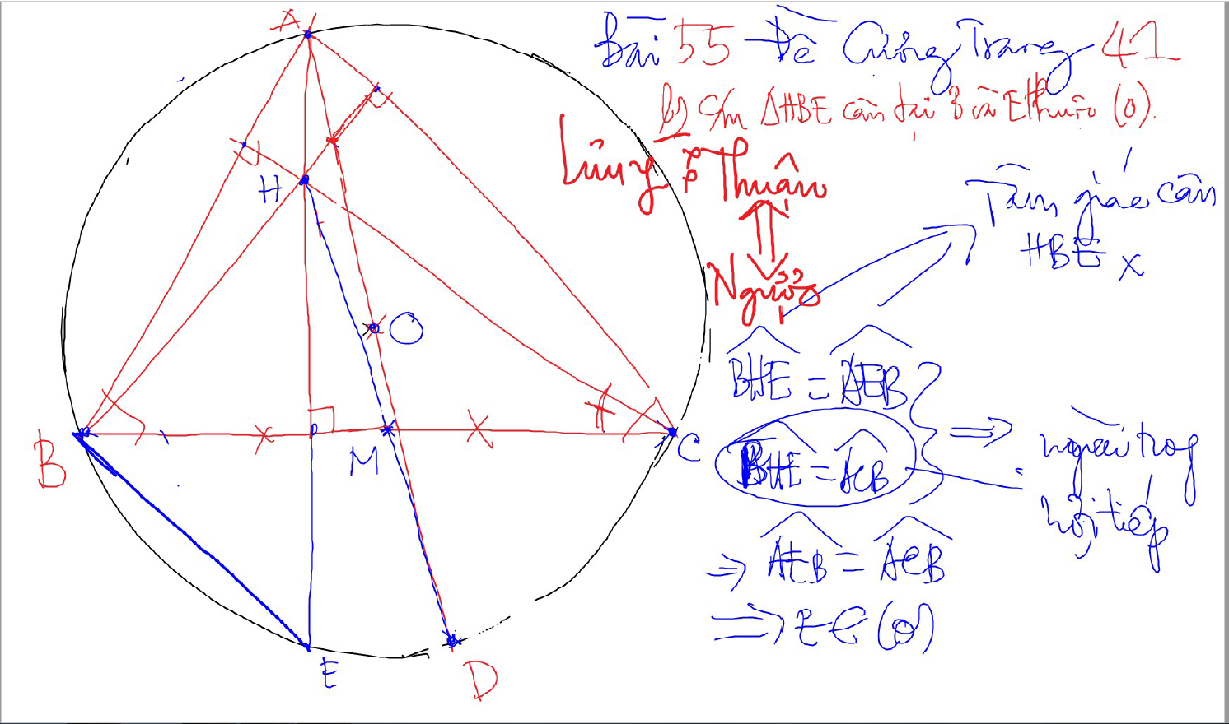

Slide 51


Slide 52


Quan he giua canh day va khoang cach den truc tam
AH²+BC²$=4R$²
CH²+AB²=4R²
BH²+AC²=4R²

Slide 53


Truc Tam: 6 tu giac noi tiep

Slide 54

Truc tam: Tinh chat chan 3 duong cao
Chan 3 duong cao tao thanh tam giac DEF
3 duong cao cua tam giac ABC cung la 3 duong phan giac cua tam giac chan duong cao (DEF)
3 tam giac nho o 3 dinh (3 cai banh u) dong dang voi tam giac lon

Slide 55


3 duong trung truc dong qui, la tam cua duong tron ngoai tiep tam giac
Giao diem cua 3 duong phan giac la tam duong trong noi tiep tam giac

Slide 56


Slide 57

Cach ve duong phan giac cua goc noi tiep

Slide 58

Cach ve duong phan giac cua goc noi tiep

Slide 59

Cach ve duong phan giac cua goc noi tiep

Slide 60

Cach ve duong phan giac cua goc noi tiep

Slide 61

Cach ve duong phan giac cua goc noi tiep

Slide 62

C/m tam giac dong dang truong hop 2

